Slide 1
Annotated Bibliography Guidelines
Find and read sources
Evaluate sources

Slide 2
A Bibliography is . . .
A list of books
A list of sources on a particular subject
A list of the sources you used to write a paper

Slide 3
An Annotation is . . .
Summary
Explanation
Evaluation/Criticism

Slide 4
Annotated Bibliography =
A list of sources (books, articles, web pages, etc.) on your topic, with commentary on each source written by you. This commentary might summarize what the source is about, how it relates to your topic, which parts are particularly relevant, why the author is believable, and whether or not you agree with the information presented.

Slide 5
Annotated Bibliography
Your entries will look like this:
Author name. Title of Source. Publication
information. (MLA Citation of Source)
All sources will be formatted MLA style. Underneath each source you will be including a paragraph summarizing the source. The more detailed this paragraph, the better and a critique paragraph evaluating the source. The slides that follow in these lecture notes describe the guidelines for finding the sources and writing the notes. It is especially important to use appropriate sources when doing academic research.

Slide 6

Purpose
The purpose of an annotated bibliography is to help you keep a running log of the research you have done and be able to quickly look back at its contents and
their usefulness.

Slide 7

Purpose
An annotated bibliography also provides a starting point when researching a topic you want to discover more about.

Slide 8
Starting the process
Your Annotated Bibliography is the starting point for your research. As you look for information, make a list of the sources you find and evaluate each one.

Slide 9
Annotated Bibliography
You should begin exploring in search of sources for your Annotated Bibliography / paper.
You should begin collecting sources and taking notes.
You will need to find the number of sources your teacher identifies for your Annotated Bibliography.

Slide 10

Jot it down!
The following guidelines are good to follow for any research process:
As you explore sources, make certain to write down the following information about any sources you are considering…

Slide 11

Jot it down!
Author’s name, title, and credentials
Title of the article
Publication information, including:
    name of database
    newspaper/ magazine/ journal/ encyclopedia/ anthology name…
    Volume numbers
    city of publication, publisher
    organization connected to the source
    date of publication, date viewed by student, page numbers, website address

Slide 12
Jot it down!
Example source on
“38 Who saw Murder”
Author’s name, title, and credentials
  Jim Rasenberger
  author & journalist for The New York Times
Title of the article:
  “Nightmare on Austin Street.”
Publication information
  American Heritage
  57.5 (2006): 65-66
  TCC database: Academic Search Complete. EBSCO

Slide 13
Plug information in to MLA format
Here is the source in MLA format:
Rasenberger, Jim. “Nightmare on Austin Street.” American Heritage. 57.5 (2006): 65-66. Academic Search Complete. EBSCO. TCC Library, Portsmouth, VA. 12 Nov. 2008.
<http://search.ebscohost.com>.

Slide 14
The Summary
Write 4–6 complete sentences that accomplish all/most of the following:

Slide 15

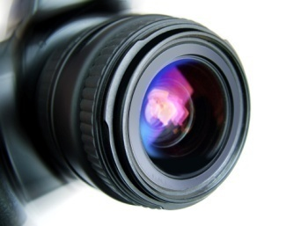

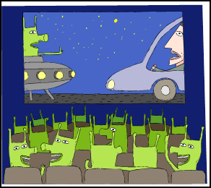
The Summary
  Provide the background and credibility of the author
  State the main focus or purpose of the work.
  Briefly describe the contents.
  Indicate the possible audience for the work.

Slide 16
The Evaluation
Write 2-4 complete sentences that accomplish all/most of the following:

Slide 17

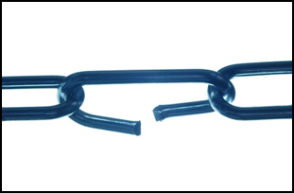


The Evaluation
Describe any special features of the work that were unique or helpful ( Aims & Research Methods).
Point to any defect, weakness, or suspected bias. (fallacies or limitations)
Mention important conclusions or observations reached by the author
Evaluate the usefulness or relevance to your research topic (Reflection/Usefulness to your research or topic Will you use this source? And/or why it did not meet your expectations.., How will the source support your narrowed down focus?)

Slide 18
The Annotation
A sample:
Jim Rasenberger, an author and journalist for the New York Times, asserts that the events as described by Gansberg in “38 Who Saw Murder” could not have happened the way Gansberg described them. Rasenberger states that although 38 people may have heard or seen the initial attack, Genovese was attacked three times. The most serious attack occurred in the back foyer of her apartment building, and could have been witnessed by five or six people at most.
He concludes his article by saying that if Gansberg’s account had been accurate, countless articles and books would never have been written about the incident and Americans’ apathy would not have been studied as thoroughly. He seems pleased that the initial and most famous account was flawed. Rasenberger’s article is interesting, but contains few facts and little research to support his assertions. The article is helpful as a starting point for a critical view of Gansberg’s article.

Slide 19
On the next slide, you will see the same paragraphs color-coded by specific criteria…
Background & credibility of author Possible Audience
Main idea Contents Usefulness to my topic/research

Slide 20
The Annotation
Jim Rasenberger, an author and journalist for the New York Times, asserts that the events as described by Gansberg in “38 Who Saw Murder” could not have happened the way Gansberg described them. Rasenberger’s assumes his audience is familiar with Gansberg’s famous and widely published article. Rasenberger states that although 38 people may have heard or seen the initial attack, Genovese was attacked three times. The most serious attack occurred in the back foyer of her apartment building, and could have been witnessed by five or six people at most.
He concludes his article by saying that if Gansberg’s account had been accurate, countless articles and books would never have been written about the incident and Americans’ apathy would not have been studied as thoroughly. He seems pleased that the initial and most famous account was flawed. Rasenberger’s article is interesting, but contains few facts and little research to support his assertions. The article is helpful as a starting point for a critical view of Gansberg’s account of events.
Background & credibility of author Possible Audience
Main idea Contents Usefulness to my topic/research

Slide 21
Completed Example Annotated Bibliography entry
Rasenberger, Jim. “Nightmare on Austin Street.” American Heritage. 57.5 (2006): 65-66. Academic Search Complete. EBSCO. TCC Library, Portsmouth, VA. 12 Nov. 2008. <http://search.ebscohost.com>.
Jim Rasenberger, an author and journalist for the New York Times, asserts that the events as described by Gansberg in “38 Who Saw Murder” could not have happened the way Gansberg described them. Rasenberger states that although 38 people may have heard or seen the initial attack, Genovese was attacked three times. The most serious attack occurred in the back foyer of her apartment building, and could have been witnessed by five or six people at most.
He concludes his article by saying that if Gansberg’s account had been accurate, countless articles and books would never have been written about the incident and Americans’ apathy would not have been studied as thoroughly. He seems pleased that the initial and most famous account was flawed. Rasenberger’s article is interesting, but contains few facts and little research to support his assertions. The article is helpful as a starting point for a critical view of Gansberg’s article.

Slide 22
Sources
Where can college students find reliable, scholarly sources?

Slide 23


Old habits…
Many students do “research” by using a general search engine such as Google.
This type of search is a habit that does not work well when doing college research.

Slide 24

Why not Google or Wikipedia?
On the Internet….
No selection process: Documents do not undergo any selection process but rather are placed there at will by anyone with access to a web server.

Slide 25


Why not Google or Wikipedia?
No standards: There is no overall effort, nor any rules or standards, to organize information to facilitate retrieval. Often, commercial sites or sites soliciting donations dominate search results.

Slide 26

Why not Google or Wikipedia?
No validation: No one reviews sites for accuracy. The internet is filled with hoaxes, scams, parodies, and hate speech disguised as “fact.”

