Slide 1
The Reformation
GERMANY DIVIDED INTO SEVERAL STATES

Slide 2
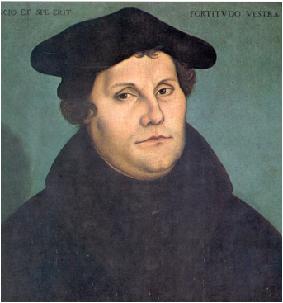
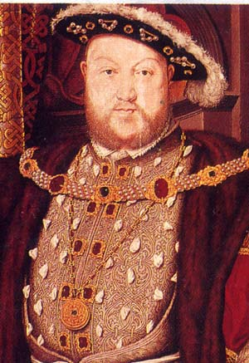
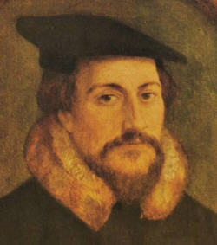
Protestant Reformation
When the Church refused the call for reform, these “reformers” broke away in “protest” & formed their own churches.

Slide 3
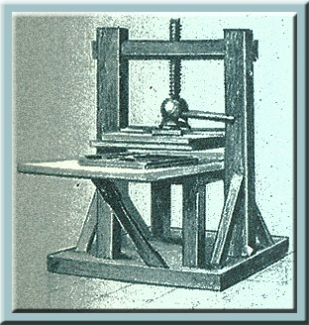
Causes of the Reformation
Social causes
1. Renaissance values of Humanism and Secularism
2. The printing press

Slide 4
Criticisms of Catholic Church
Leaders of the church were corrupt
Popes spent money on personal pleasure, art, and fighting wars
Priests poorly educated, drank to excess and gambled, married and fathered children

Slide 5
Early Calls for Reform
John Wycliffe and Jan Hus – 1300 and 1400’s
Desiderius Erasmus and Thomas Moore – 1500’s
Many Europeans were reading religious works and forming their own opinions about the church.

Slide 6
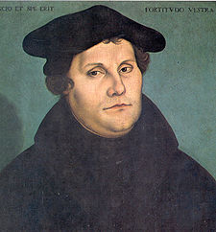
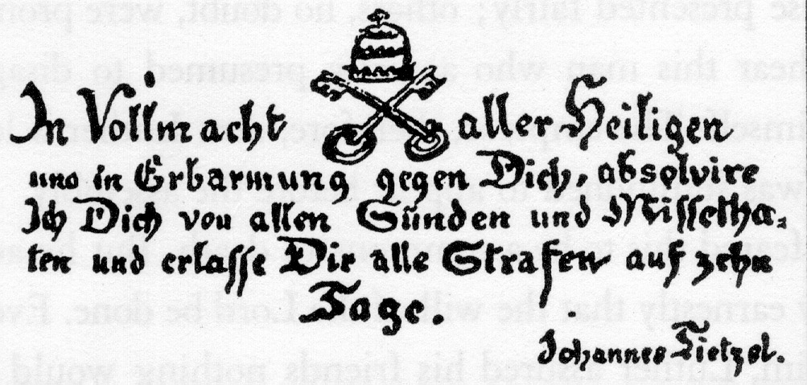
Martin Luther
German monk/teacher who spoke against Johann Tetzel
Selling of indulgences(Pardon) to raise money
Wrote 95 Thesis (formal charges against Catholic Church)
Started the reformation- movement for religious reform.
Started Lutheranism

Slide 7
LUTHERANISM
People receive salvation
through faith alone
Bible is sole source
All people of faith are
equal

Slide 8
OPPOSITION TO LUTHER
EMPEROR
Charles V
Issued the EDICT OF WORMS- declared him a outlaw and heretic
POPE
Excommunicated him
PEASANT REVOLT
Saw words as revolutionary started to rebel
Saw Luther as a trader

Slide 9
German Civil War
Catholic (Charles V) vs. Protestant
Charles V defeated Protestants in 1547
Peace of Augsburg (1555)- Each German ruler would decide the religion of his state.

