Slide 1
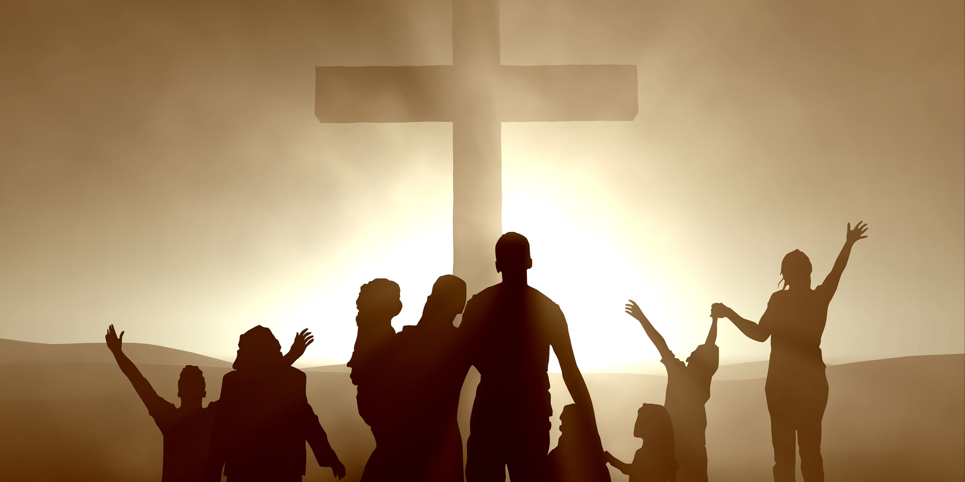
SOCIETY DIVIDES OVER RELIGION
CATHOLICS
PROTESTANTS
Those who continue to follow the teachings of the Catholic Church
Those who follow the teachings of any other Christian sect aside from Catholicism

Slide 2
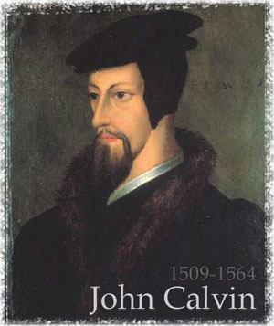
John Calvin
French humanist who started Protestant branch in Geneva, Switzerland
Believed people are sinful in nature
Future was predetermined- their was nothing they could do to change their destiny
Salvation came only from God`s grace- God chose who would be “saved”

Slide 3
Those who believed in John Calvin and his teachings started a new sect of Christianity known as…

Slide 4
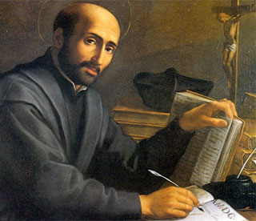
Counter-Reformation
Catholic Church`s response to the Protestant Reformation in an attempt to bring members back to the Catholic Church
Founded by Ignatius of Loyola
Followers are called Jesuits
“Society of Jesus”
Renewed church`s emphasis of spirituality and service

Slide 5
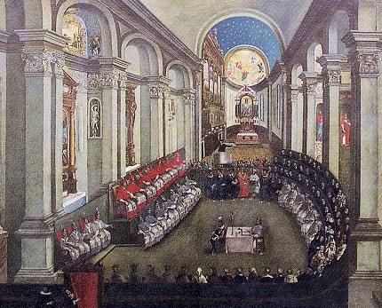
The Council of Trent
1545, Church members decided to redefine some religious doctrines of the Catholic Church.
Addresses Abuses of church officials
Addressed Corruption
Training of Priests regulated
Addresses Financial Abuses
Sale of Indulgences abolished
Basic structure of Church reaffirmed!

