Slide 1
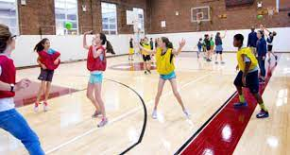
WELCOME TO PHYSICAL EDUCATION
Physical Education class is designed to teach students how to live a healthy and physically active lifestyle while improving student’s fitness levels through participation in various sports and activities. Phys Ed teaches students sportsmanship and gives students an opportunity to interact and learn how to work together. Each student will have three marking periods of PE and one marking period of health in a classroom.

Slide 3
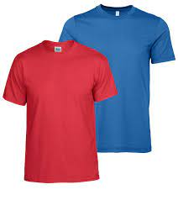
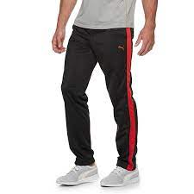
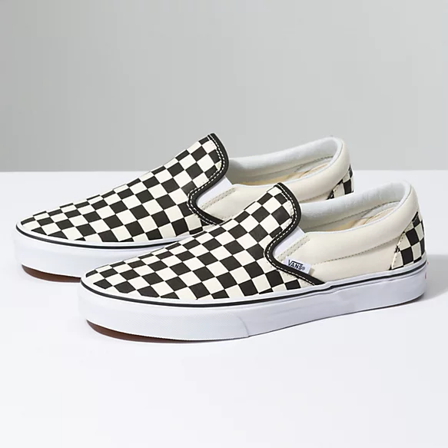
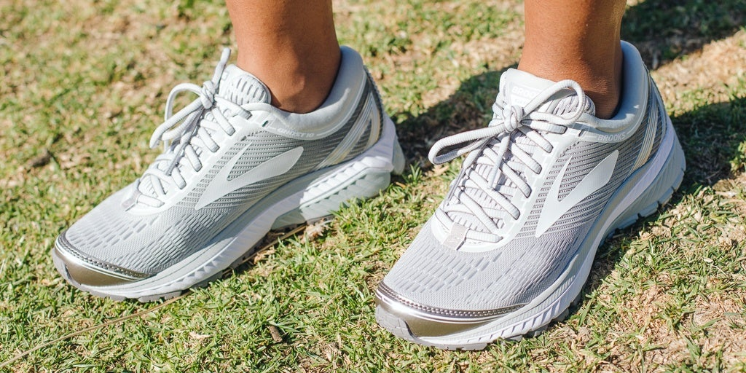
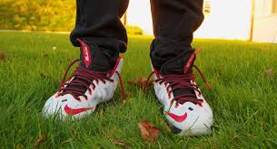
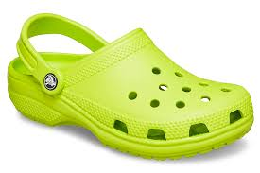
PREPARATION
Wear appropriate PE clothing to school on your PE days. Athletic clothing is recommended. No tank tops.
You need sneakers and they must be tied.
YES
NO
NO
NO

Slide 4
3. Remove inappropriate jewelry.
4. NO CELL PHONES
Students may not have a cell phone out during class and they can not be in their pockets. Phones should be left in school lockers or back packs during class.

Slide 6
CLASS RULES & PROCEDURES
Display good sportsmanship at all times.
Be respectful of others.
Be attentive when a teacher is speaking.
Follow all instructions given.
Maintain safe play.
No gum, candy, or food allowed.
Students should be seated in their squad spot and facing forward during attendance and warm-ups.
Use appropriate language.
Cell phones are not permitted during class at any time.
Three whistles = stop, sit, and listen.
Remain in your squad until the bell rings.

Slide 8
CLASS ROUTINE
Enter the gym in the far door and put bags in bleachers.
Get prepared for class.
Walk laps around the gym unless told otherwise.
Attendance in squads.
Exercises / Stretching
Daily activity / workout
Clean and put away any equipment.

Slide 9
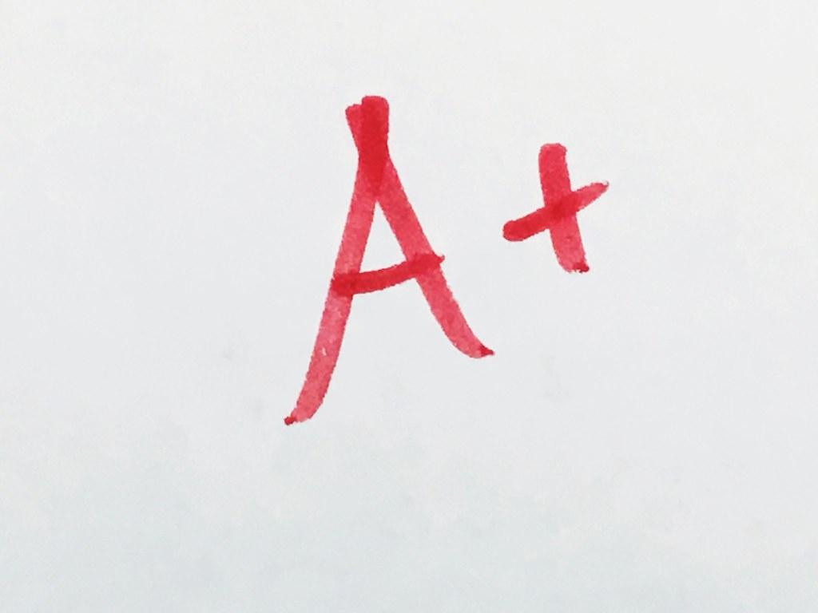
GRADING
Students are graded on their
Class participation
Preparation / Conduct
Skills / Knowledge
Grades are entered on Genesis every five class days with the possibility of earning twenty points a day for participation and preparation / conduct. Students will also be assessed on their skills and knowledge at the end of each unit.

Slide 10
ABSENCES
If you are absent from class you are responsible for making up your absence in order to receive credit for participation. To make up your absence get at least 30 minutes of exercise on your own time. Then fill out and submit the Phys Ed make up form found on our Google classroom.

