Slide 1
PERIODIC TABLE
MAP OF THE ELEMENTS
Bonding Models (11:37)

Slide 2
PERIODS OF ELEMENTS
Elements are placed in periods going horizontally (across) the periodic table
Each row begins as the pattern of physical and chemical properties repeats itself
There are 7 rows, or periods, on the Periodic Table

Slide 3
PERIOD FACTS
The size of atoms decrease
Atomic # and Atomic Mass increase
The elements change from metals through metal-like (metalloids) elements to nonmetals
The row number indicates the number of electron energy levels

Slide 4
FAMILIES OF ELEMENTS
Elements with similar arrangements of electrons have similar properties.
Elements with similar electron arrangements are grouped together in families, or groups.
There are 18 groups or families.

Slide 5
Why do elements in the same family have similar properties?
Family number tells how many electrons are in outer energy level.
The number of electrons in the outer energy level of an atom determines if and how the element will combine with other elements.

Slide 6
Circle your level of understanding of these concepts:
1 2 3 4

Slide 7
STAIR-STEP LINE
Found on the right side of the table.
The elements to the left are metals (except hydrogen)
The elements to the right are non-metals
On either side of the stairs are the metalloids

Slide 8
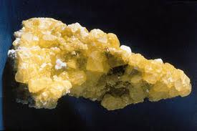
PROPERTIES OF NON-METALS
Many are gases at room temp
The solids are easily crushed and do not shine
Do not conduct
heat and electricity
Sulfur

Slide 9
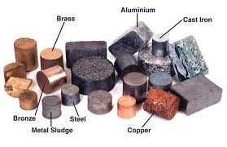
PROPERTIES OF METALS
Solid at room temperature
Shiny, malleable (bendable), & ductile (flexible)
Good conductors of heat and electricity

Slide 10
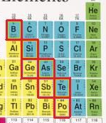
PROPS OF METALLOIDS
Have properties of both metals and non-metals
Dull in color
Not malleable (bendy)
Conduct a current
& heat
Solids at room temp

Slide 11
REACTIVITY OF ELEMENTS
The most reactive metals are in the lower left corner of the Periodic Table
Not counting Family 18, the most reactive gases are in the upper right corner

Slide 12
Circle your level of understanding of these concepts:
1 2 3 4

Slide 13
Octet Rule
Elements usually combine in a way that will give them 8 electrons in their outer (last) energy level.
The exceptions to this rule are elements like hydrogen and helium with only a first energy level, with 2 electrons.

Slide 14
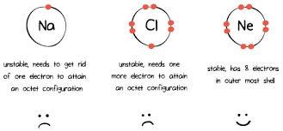
Sodium and Chlorine will transfer electrons and form ions to achieve the Octet Rule.
Ion- atom with a different amount of electrons, forming a charged atom.

Slide 15
Ionic Bonds
An ion is a charged atom caused by the transfer (loss or gain) of electrons.
A positively charged ion has lost electrons; mainly metals.
A negatively charged ion has gained electrons; mainly non-metals.
An ionic bond forms from the attraction of positive and negative ions.

Slide 16
Example of ionic bonding
Na + Cl Na⁺Cl⁻
Na⁺ + Cl ⁻ salt
Sodium, with one outer electron will become a positive ion when it gives its one electron to chlorine.
Chlorine will become a negative ion.

Slide 18
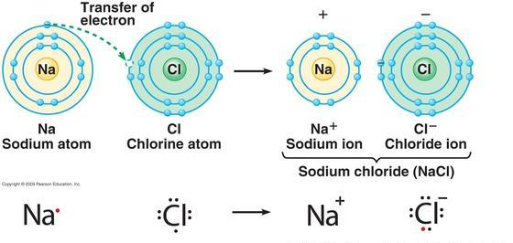
Na⁺Cl⁻
Salt

Slide 19
Ionic Bonds
Metals | Non-Metals
Mostly in Groups 1, 2, 13, or 14 | Mostly in Groups 14,15, 16, or 17
1, 2, 3, or 4 valence e⁻ in the last energy level | 4, 5, 6, or 7 valence e⁻ in the last energy level
Gives away valence e⁻ to non-metal atoms | Takes EXTRA valence e⁻ from the metal atoms
Forming positive ions; 1+, 2+, 3+, or 4+ | Forming negative ions; 4-, 3-, 2-, or 1-
Group 18 already has 8 e⁻, does NOT makes bonds, nor molecules

