Slide 1
Parent Guide to
enVisionMath2.0
Online Resources
Jackson Township School District
2016/2017

Slide 2
Quick Links Menu
Click the links below to navigate through the slides.
How you can help your child at home
Using the Bounce Pages App for homework help
Logging into Pearson Realize
Online Math Resources - Pearson Realize
What’s available?
How to find them...
Student’s Edition eBook
Visual Learning & Another Look Video Tutorials
Practice Buddy
ACTIVe-Book
Student Assignments
Assignment Results and Standards Mastery

Slide 3
How you can help your child at home
View the lesson through the eBook on PearsonRealize.com
Watch the video tutorials
Use everyday objects to model math (coins, paperclips, etc)
Practice fast facts as much as possible (addition, subtraction, multiplication and division)
Ask your child to explain his/her thinking and reasoning
Use the Bounce Pages App
Back to Menu

Slide 4
Using the Bounce Pages App
Download the Pearson Bounce Pages app in your Apple App Store or Google PlayStore
2. Open the app
and have
your
Homework &
Practice
page ready.
Next Slide

Slide 5
Using the Bounce Pages App
3. AIM the camera so the ENTIRE Homework & Practice page is viewable
4. TAP the screen to scan the entire page
5. Click Common Core English or Common Core Spanish and the page will BOUNCE to life.
The ‘Another Look’ that you are taken to will help with understanding how to solve the homework problems!
Next Slide

Slide 6
Using the Bounce Pages App
Tips & Troubleshooting
The Bounce Pages App only works if you scan the FRONT SIDE of the HOMEWORK & PRACTICE page.
Scan the ENTIRE page. Scanning a single problem will not work.
Scan the page BEFORE your child writes on it!
Ensure a strong internet connection.
Update the Bounce Pages App and Update the Operating System on your device if you are having trouble using the app.
Back to Menu

Slide 7
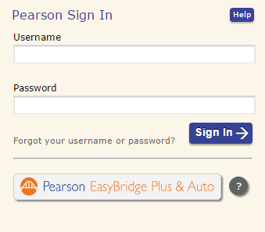
Logging into Pearson Realize
Go to pearsonrealize.com and click ‘Sign In’ at the upper right.
IMPORTANT: Click Pearson Easy Bridge Plus & Auto
CLICK HERE!
Next Slide

Slide 8
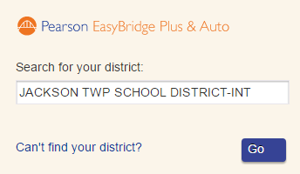
Logging into Pearson Realize
3. In the ‘Search for your district’ box, type JACKSON TWP SCHOOL… You will see our district name come up in a list. Be sure to choose the same as you see here.
Next Slide

Slide 9
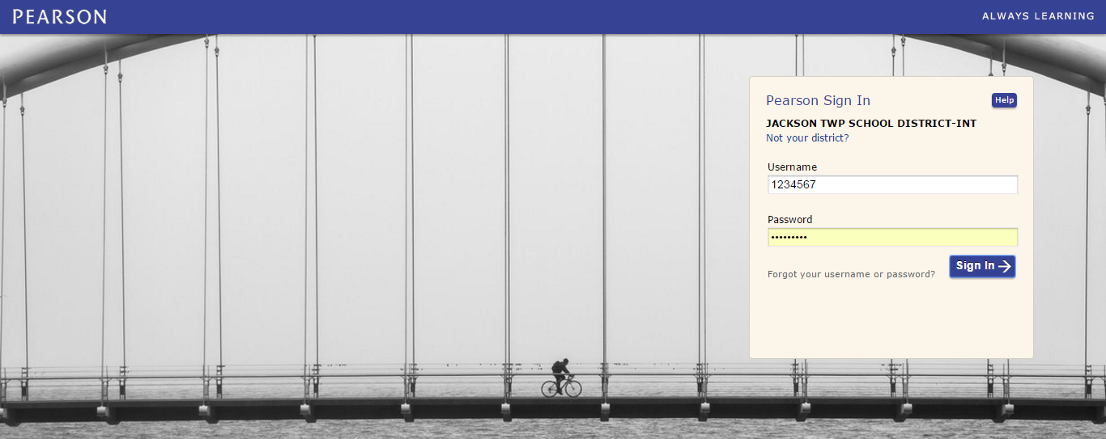
Logging into Pearson Realize
3. Make sure you see the same image as you do below.
There should be a person riding a bicycle on a bridge.
Next Slide

Slide 10
Logging into Pearson Realize
4. Enter your login credentials:
Username: Student ID Number (eg 1122456)
Password: Student’s First Name and Grade (eg Matthew03)
*For the password, the first letter must be capital and include the zero with the grade; 01, 02, 03, 04, 05 or KF for Kindergarten.
Next Slide

Slide 11
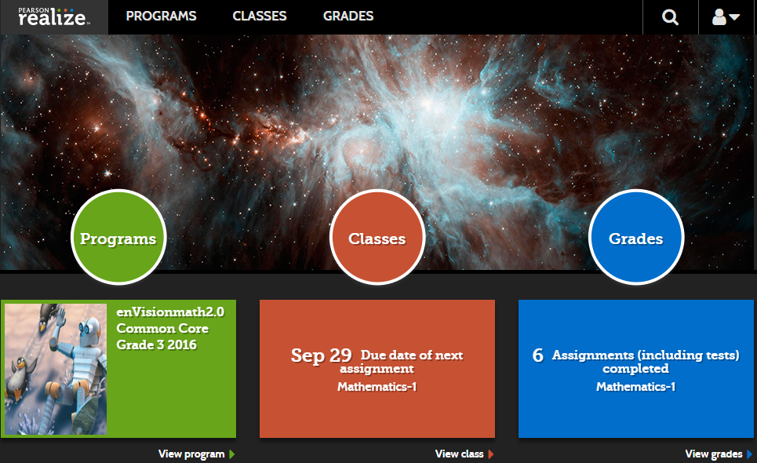
Logging into Pearson Realize
You will have three categories to choose from when you log in:
Programs - use online resources
Classes - view your assignments
Grades - view your grades
Back to Menu

Slide 12
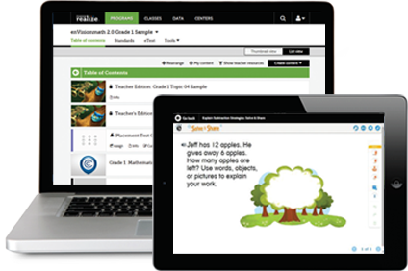
Online Math Resources
What’s available?
Student Edition eText - Virtual textbook
Visual Learning Video - Animated lesson video
“Another Look” videos - Video tutorials
Math Games - Games for math practice
Practice Buddy for Homework Help - Teacher assigned practice
Back to Menu
Next Slide

Slide 13
Online Math Resources
How to find them...
HERE
Once you are logged into your student’s Pearson Realize account, click PROGRAMS.
OR HERE
OR HERE
Next Slide

Slide 14
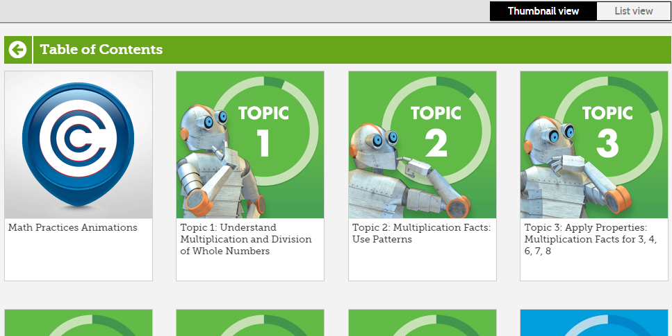
Online Math Resources
How to find them...
Now choose a Topic.
This is “Thumbnail View” and can be changed to List View if you prefer. Just click “List View” at the upper right.
Next Slide

Slide 15
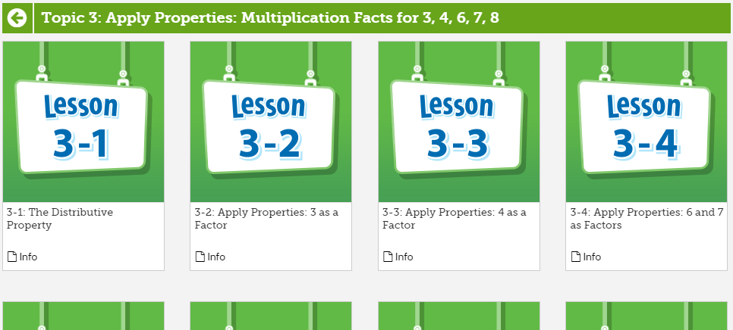
Online Math Resources
How to find them...
Choose a Lesson.
Next Slide

Slide 16
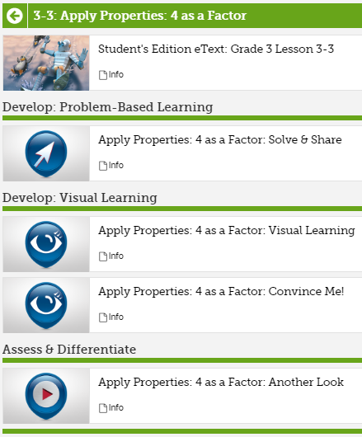
Online Math Resources
How to find them...
For all lessons, you will be able to access:
Student’s Edition eText
Solve & Share
Visual Learning
Convince Me! (or something similar)
Another Look Video
Math Games (if available for the lesson chosen)
Other resources can be assigned by your teacher!
Back to Menu

Slide 17
Online Math Resources
Student’s Edition eText
Log in, choose Programs, the topic, and lesson.
Click on the Student’s Edition eText.
Click ‘Open in a New Window’
Next Slide

Slide 18
Online Math Resources
Student’s Edition eText
Navigate through the student book pages, highlight, bookmark, zoom, glossary, etc...
Opens to the lesson you chose
Table of Contents
Next Slide

Slide 19
Online Math Resources
Video Tutorials
Log in to Pearson Realize
Go to Programs
Click the Topic and Lesson
Choose Visual Learning or Another Look
Visual Learning
An animated video that teaches the main math ideas in the lesson.
Another Look
A tutorial of sample problems from the lesson.
Back to Menu
Next Slide

Slide 20
Online Math Resources
Practice Buddy
Looking for more practice?
Ask your teacher about Practice Buddy
Practice Buddy is an online digital component available to students in Grades 3-5. If assigned by their teacher, students have Practice Buddy for the Independent Practice, Math Practices & Problem-Solving, and the Homework & Practice portion a lesson. Using Practice Buddy, students have the opportunity to use a variety of question help tools to complete each problem at their own pace.
Next Slide

Slide 21
Online Math Resources
Practice Buddy
If the Practice Buddy is assigned by your teacher, to find it:
Log in to Pearson Realize
Click Classes
Choose the Practice Buddy in you list of assignments.
Back to Menu

Slide 22
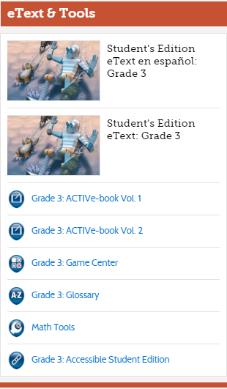
Online Math Resources
ACTIVe-Book
To access the ACTIVe-Book and other Math Tools…
Log in to Pearson Realize
Click Classes
On the right side of your screen, find ACTIVe-Book Vol. 1 and Vol. 2
Also notice some other great tools here. The Game Center, Glossary, and Math Tools.
Next Slide

Slide 23
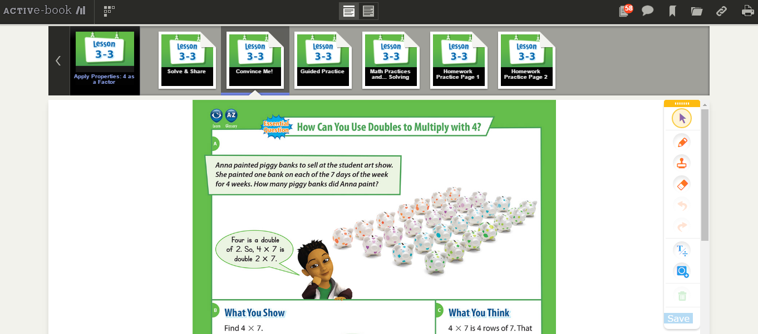
Online Math Resources
ACTIVe-Book
Print Pages
Table of Contents
Use these tools to write on the pages
Back to Menu

Slide 24
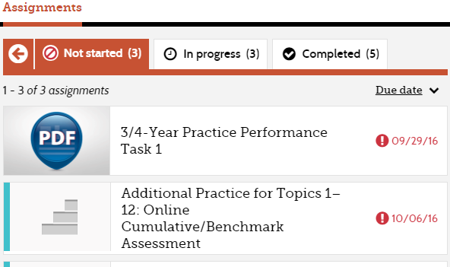
Student Assignments
To find your assignments (tests, practice, and other resources assigned by your teacher):
Log in to Pearson Realize
Click Classes
Find assignments organized in tabs
Not Started
In Progress
Completed
Clicking on a Completed assignment will show results of that assignment.
Back to Menu

Slide 25
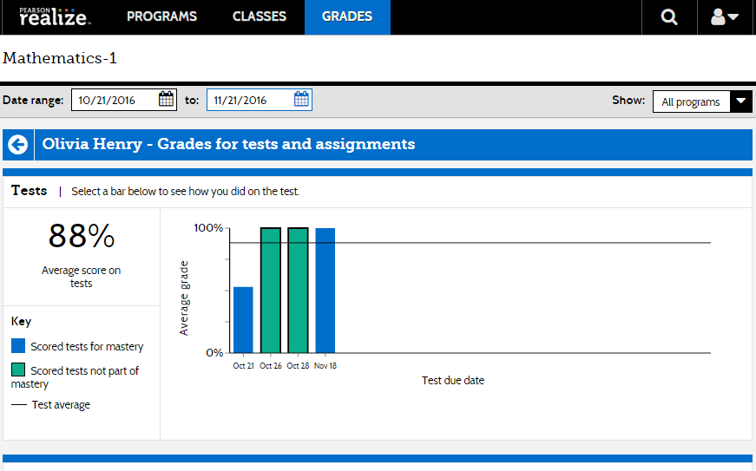
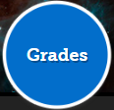
Assignment Results and Standards Mastery
To view detailed results of tests and graded assignments:
Log in to Pearson Realize
Click Grades
Click one of the bars
to view an assignment
Green bars represent assignments that count towards standards mastery
Blue bars are assignments that were not graded for standards mastery data.
Student
Click a bar
Next Slide

Slide 26
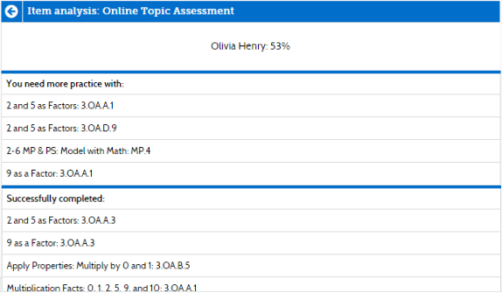
Assignment Results and Standards Mastery
Student:
Based on Assignment results, you will find a list of standards that need more practice and a list of standards that were successfully completed.
Next Slide

Slide 27
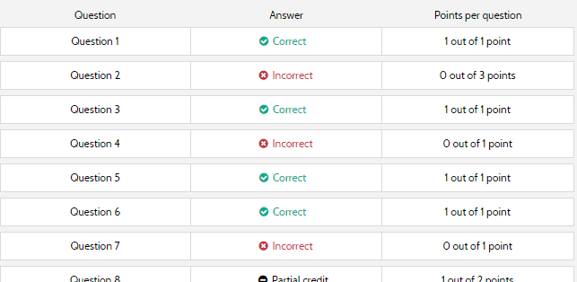
Assignment Results and Standards Mastery
Scroll down to find an item analysis.
To see each question from the assignment, go back to Classes and open the assignment in the ‘completed’ tab.
Back to Menu

