Slide 1
Elements combine to form compounds Chemistry of a Snowflake (5:59) Types of Bonds (9:45)

Slide 2
Background & Review Information

Slide 3
Octet Rule
Elements usually combine in a way that will give them 8 electrons in their outer (last) energy level (stable).
The exceptions to this rule are elements like hydrogen and helium with only a first energy level, with 2 electrons.

Slide 4
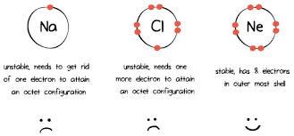
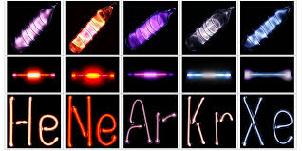
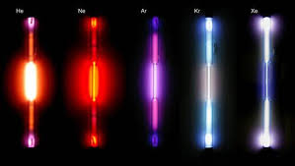
If an atom has 8 electrons, it is stable, non-reactive.
Example: Group 18; Noble gases

Slide 5
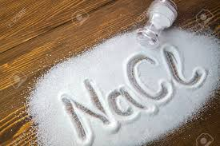
If an atom has less than 8 electrons, it is unstable, reactive.
Example 1: Ion- an atom with a different amount of electrons, forming charged atoms
Na + Cl = NaCl (salt)

Slide 6
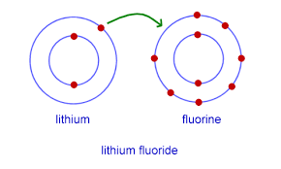
Examples of an other ionic bond:
Ionic bond: exchange of electrons causing opposite charges to attract creating a weak bond
(ALWAYS metal and non-metal)
Fun fact: Lithium fluoride is used in brazing or soldering fluxes and in welding rod coatings.

Slide 7
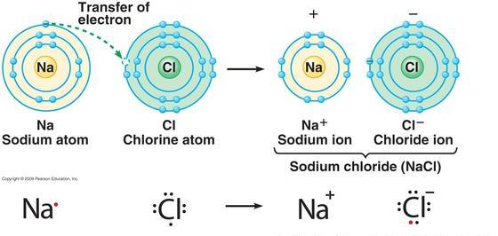
Na⁺Cl⁻
Salt
Sodium, with one outer electron, will become a positive ion when it gives its one electron to chlorine. Chlorine will become a negative ion.
This chemical reaction creates a NEW substance, salt.

Slide 8
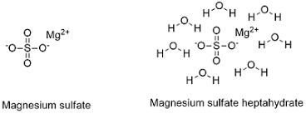
Examples of another fancy ionic bond:
Fun fact: Rock salt is used to change the freezing point in water i.e. salting the sidewalk or making ice cream

Slide 9
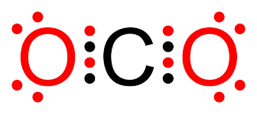
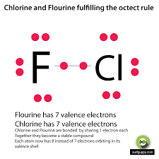
Covalent Bonds
Example 2: Covalent bonds- atoms share lone electrons to create a pair of electrons
(ALWAYS non-metals)

Slide 10
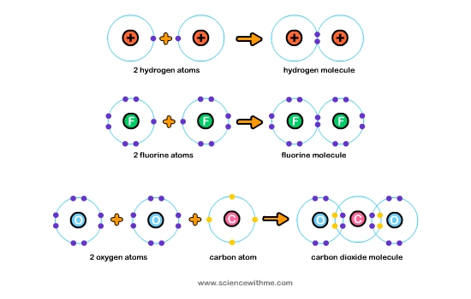

Slide 12
Ionic
The metal atom gives electrons to the non-metal atom
Covalent
The non-metal atoms share electrons with each other

Slide 13
Circle your level of understanding of these concepts:
1 2 3 4

Slide 14
Compounds have different properties from elements
Elements have individual properties that help us identify them.
Although, when these elements combine to form compounds, a whole new set of properties are made.
Example: carbon (C) and oxygen (O) alone are harmless, but carbon monoxide (CO) is deadly.

Slide 15
Forming Compounds: Chemical Reactions
The reacting atoms are rearranged and bonds are made
Producing new substances with new properties
Examples:
Na + Cl → NaCl (salt)
N₂ + 3H₂ → 2NH₃ (ammonia)

Slide 16
Diagram each molecule: Carbon atom Oxygen atom
Carbon monoxide (CO) | Carbon dioxide (CO₂)
Hint: Put ALWAYS put Carbon atoms in the middle

Slide 17
Diagram each molecule: Carbon atom Hydrogen atom Nitrogen
Methane (CH₄) | Ammonia (NH₃)

Slide 18
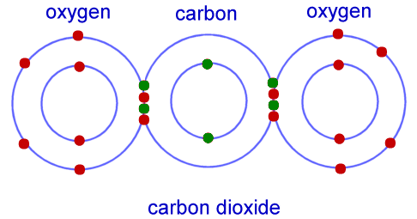
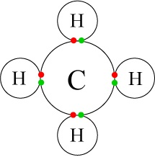
CO₂
CH₄
Methane

Slide 19
Circle your level of understanding of these concepts:
1 2 3 4

Slide 20
Atoms combine in predictable numbers
Water (H₂O) will always have 2 hydrogen atoms for every oxygen.
2 to 1 ratio of hydrogen to oxygen 2:1
2 hydrogen atoms with 1 electron in the last energy level and 1 oxygen atom with 6 electrons in the last energy level. Sharing these will give oxygen 8 electrons & hydrogen 2 electrons, filling the last energy levels!

Slide 21
Diagram H₂O: What type of bond is formed? Ionic or Covalent
Water (H₂O)
Oxygen
Hydrogen

Slide 22
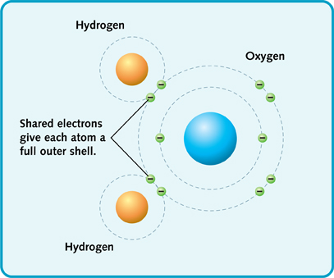

Slide 23
Salt (NaCl) will always have 1 sodium atom for every Chlorine; 1:1
Sodium atoms have 1 electron in the last energy level and Chlorine atoms have 7 electrons in the last energy level. Transferring the electrons will leave chlorine the 8 electrons & sodium has a new outer energy level already filled up with 8 electrons!

Slide 24
Diagram NaCl: What type of bond is formed? Ionic or Covalent
Salt (NaCl)
Sodium
Chlorine

Slide 25
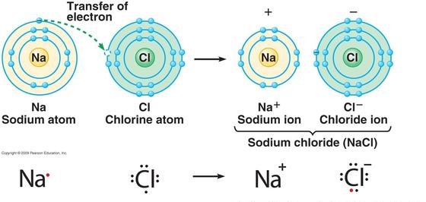
Na⁺Cl⁻
Salt

Slide 26
Circle your level of understanding of these concepts:
1 2 3 4

Slide 27
CHEMICAL FORMULAS
A chemical formula of a compound tells how much of each element is present.
Examples: CO₂ shows one atom of carbon and two atoms of oxygen.

Slide 28
SUBSCRIPTS
Subscripts are small numbers written slightly below the element symbol to show how many atoms of that element are in the compound.
When there are no subscripts the number of atoms is understood to be one.

Slide 29
SUBSCRIPTS
Examples of subscripts:
MgCl₂ is the formula for magnesium chloride. It is made up of one atom of magnesium and two atoms of chlorine.
H₂O is the formula for water. It is made up of two atoms of hydrogen and one atom of oxygen.

Slide 30
Circle your level of understanding of these concepts:
1 2 3 4

Slide 31
FAQs
What is an atom and molecule?
The ‘simple building blocks of matter’ are known as atoms. The properties of the chemical element are the smallest basic unit of a substance. Molecules are made up of one or more atoms connected by chemical bonds.
Is an atom considered a molecule?
An atom is singular and independent. A molecule is chemically bonded creating a new substance with new properties. Example: helium (atom) vs sugar (molecule of C, H, & O covalently bonded). Usually, atoms and atoms in non-covalent interactions, such as bonds of hydrogen or ionic bonds, are not called independent molecules.

Slide 32
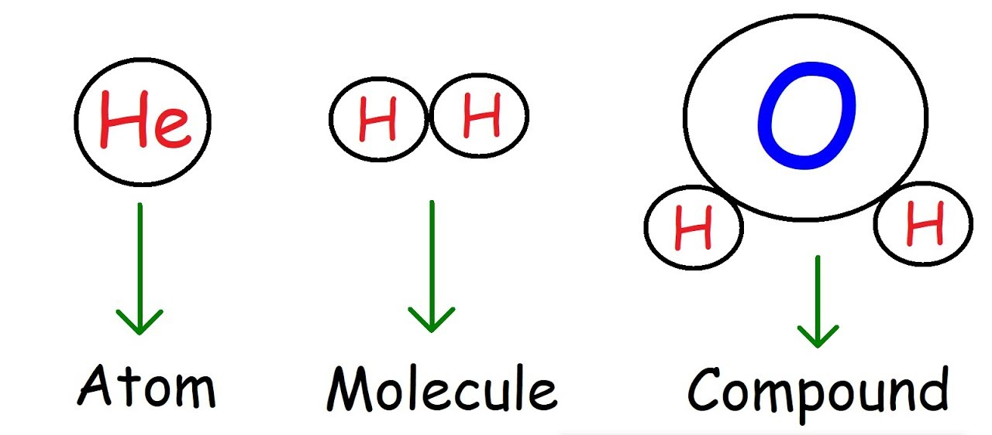
FAQs
What is a compound molecule? Are all molecules compound molecules?
A compound molecule is different atoms chemically bonded together. Example: C, H, & O covalently bonded (6:12:6 ratio = C₆H₁₂O₆ = glucose) creates a compound molecule. No, not all molecules are compound molecules. Example: oxygen gas (O₂) is two atoms of oxygen chemically bonded together but it is the same atom so it is a covalently bonded element molecule, but not a compound molecule.

Slide 33
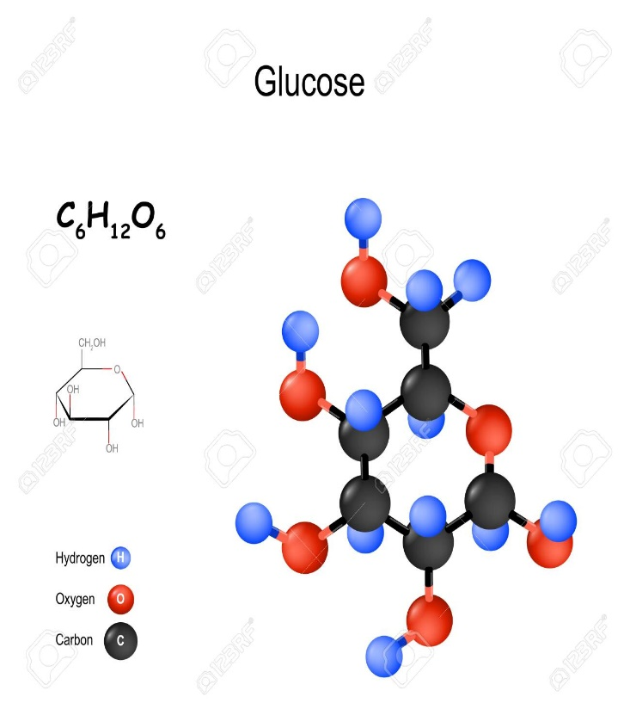
FAQs
What is the best definition of atom?
An atom is a particle of matter that describes a chemical substance in a special way. A single nucleus, which is normally surrounded by one or more electrons, consists of an atom. Each electron is charged negatively. The nucleus is charged positively, made up of protons (positive) and neutrons (neutral).
What is the smallest amount of a substance you can have?
A single molecule is the smallest amount of a substance you can have. Example: sugar (C₆H₁₂O₆ = glucose)

