Slide 1
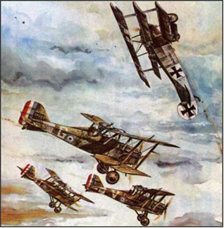
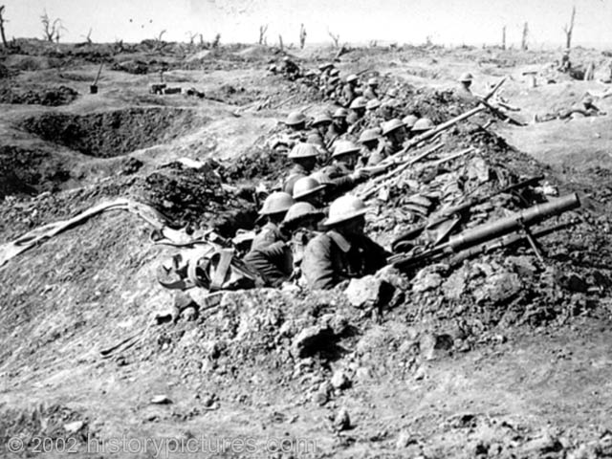
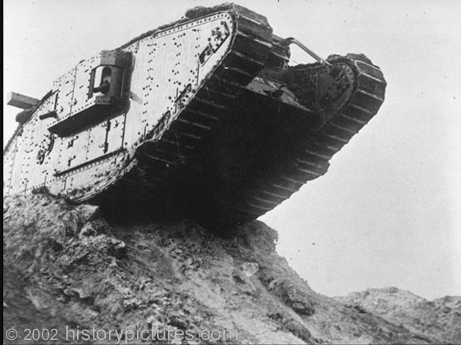
WORLD WAR I (1914-1918)
“The war to end
all wars.”

Slide 2
Use Chapter 29 – section 1
How did nationalism contribute to the start of war?
How did imperialism contribute to the start of war?
Define militarism and how did the industrial revolution make it a threat to start war?
What role did Kaiser William II play in starting war?
Why did the nations of Europe form a system of opposing alliances and why did this become dangerous?
Explain how the Balkan “powder keg” played a role in triggering world war.
Describe the “spark” that actually started the fighting?

Slide 3
CHP. 29 Homework – Due tomorrow
Define militarism and how did the industrial revolution make it a threat to start war?
Who was Kaiser William II & what role did he play in starting war?
Explain how the Balkan “powder keg” played a role in triggering world war.
Describe how the assassination in Sarajevo lead to many countries in Europe going to war in 1914.
Identify the two sides in WWI
What was the Schlieffen Plan?
Describe trench warfare.
What is meant by “total war?”
What is meant by propaganda & what role did it play during WWI?
Where was WWI fought outside of Europe?

Slide 4
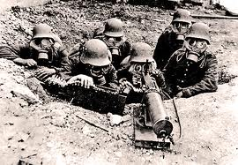
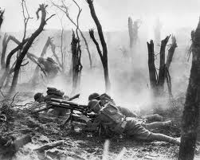
Causes of World War I
What do you think was the most significant factor / cause that led to the start of World War I?

Slide 5
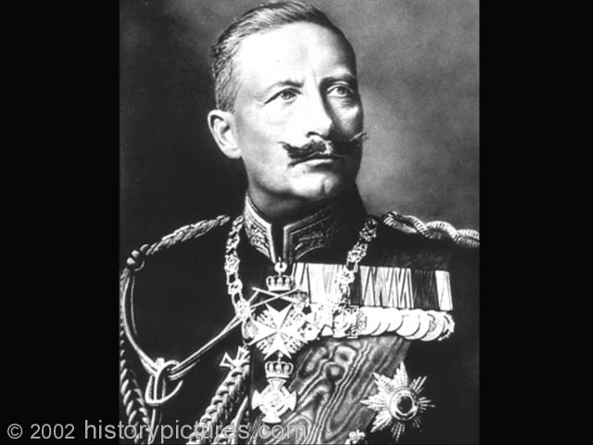
CAUSES
NATIONALISM
Extreme patriotism & pride dictates foreign policy & drives nations into competition.
Kaiser William – Germany’s “place in the sun”
France – “revenge” & Alsace /Lorraine
Russia – leader in the Balkans
Serbia – Slavic Nationalism

Slide 6
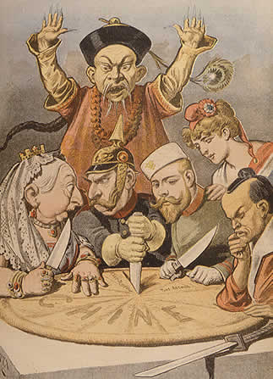
2. IMPERIALISM
Competitive expansion into weaker regions of the world result in rivalry & disputes.
Scramble for Africa
Spheres of influence in China
Motivated by industrialism & trade, pride and strategic locations
Fashoda incident (Britain & France)
Moroccan Crisis (Germany & France)
Balkans (Austria & Russia)

Slide 7
3. MILITARISM
The glorification of military strength.
Resulted from industrialized technology & pride/willingness to use modern weaponry
Need for military preparedness to deal with rivals/competitors
Support the use of a forceful policy to solve international problems (“jingoism”)

Slide 8
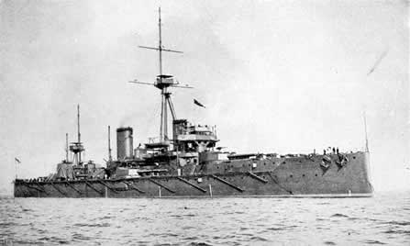
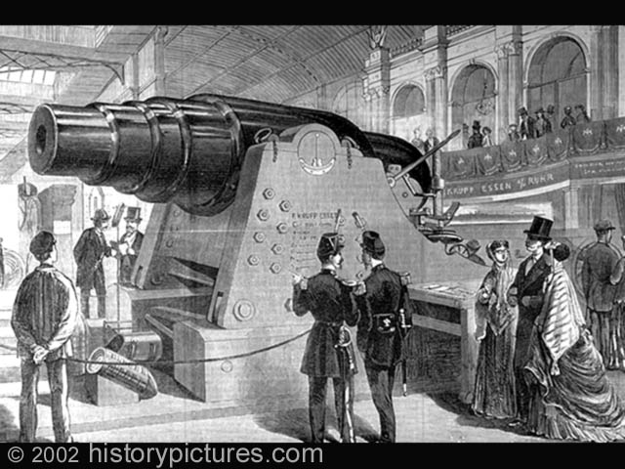
MILITARISM
Enormous sums of $ spent on defense budgets…example = naval race between Britain & Germany

Slide 9
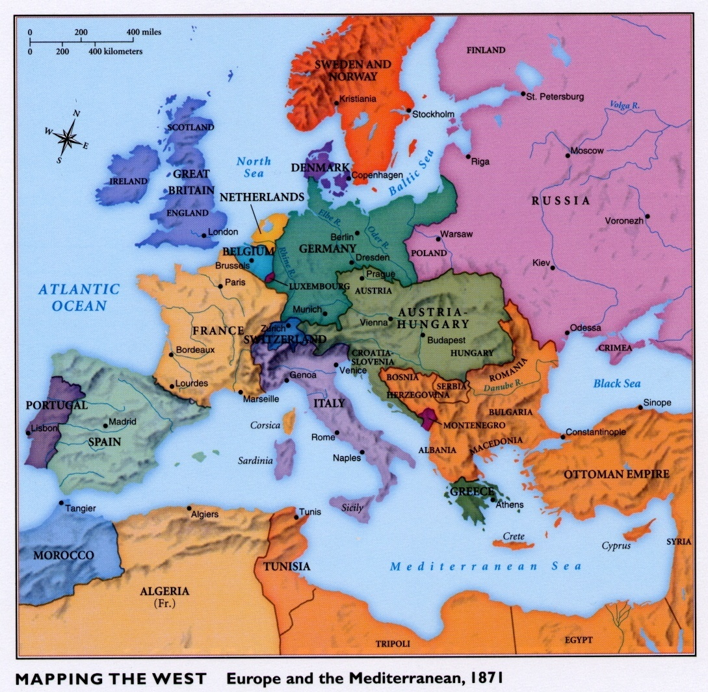
Bismarck’s Foreign Policy
Germany the strongest country on the mainland, but must isolate France = an enemy
Especially from
Russia, otherwise
Will face a
TWO-FRONT
WAR

Slide 10
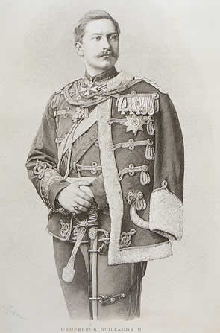
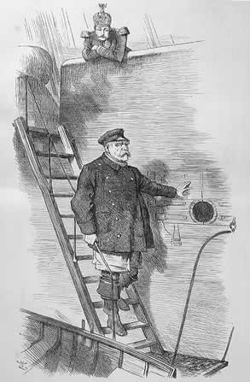
Kaiser William II (1888-1918)
1888 – William I dies and eventually replaced by his son William II
Disagrees with & replaces Bismarck…
“dropping the pilot”

Slide 11
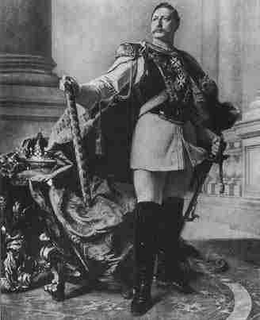
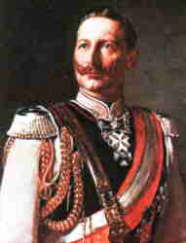
Kaiser William II (1888-1918)
Adopts a new, aggressive foreign policy
Colonial expansion & a strong navy (rivals England)
Alienates Russia (who becomes an ally of France)
William II’s actions
make enemies and
threaten the peace
of Europe.

Slide 12
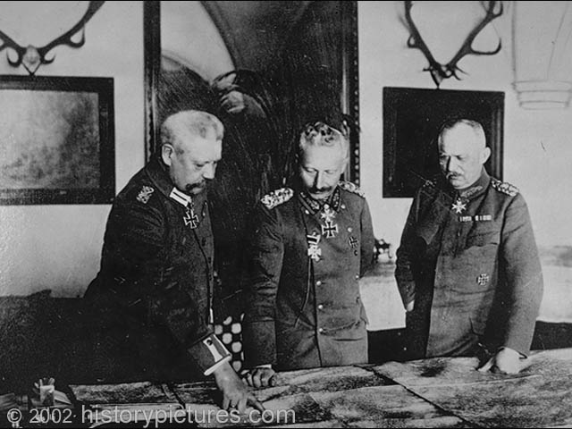
4. SYSTEMS OF ALLIANCE
Nations eager to protect themselves and maintaining the “balance of power”
Deter war or guarantee a major one?
Bismarck’s policy (1871)
Isolate France & prevent a 2-front war (Russia)
Kaiser William’s policies
Triple Alliance
(Germany, Austria & Italy) vs.
Triple Entente
(France, Russia & Britain)

Slide 13
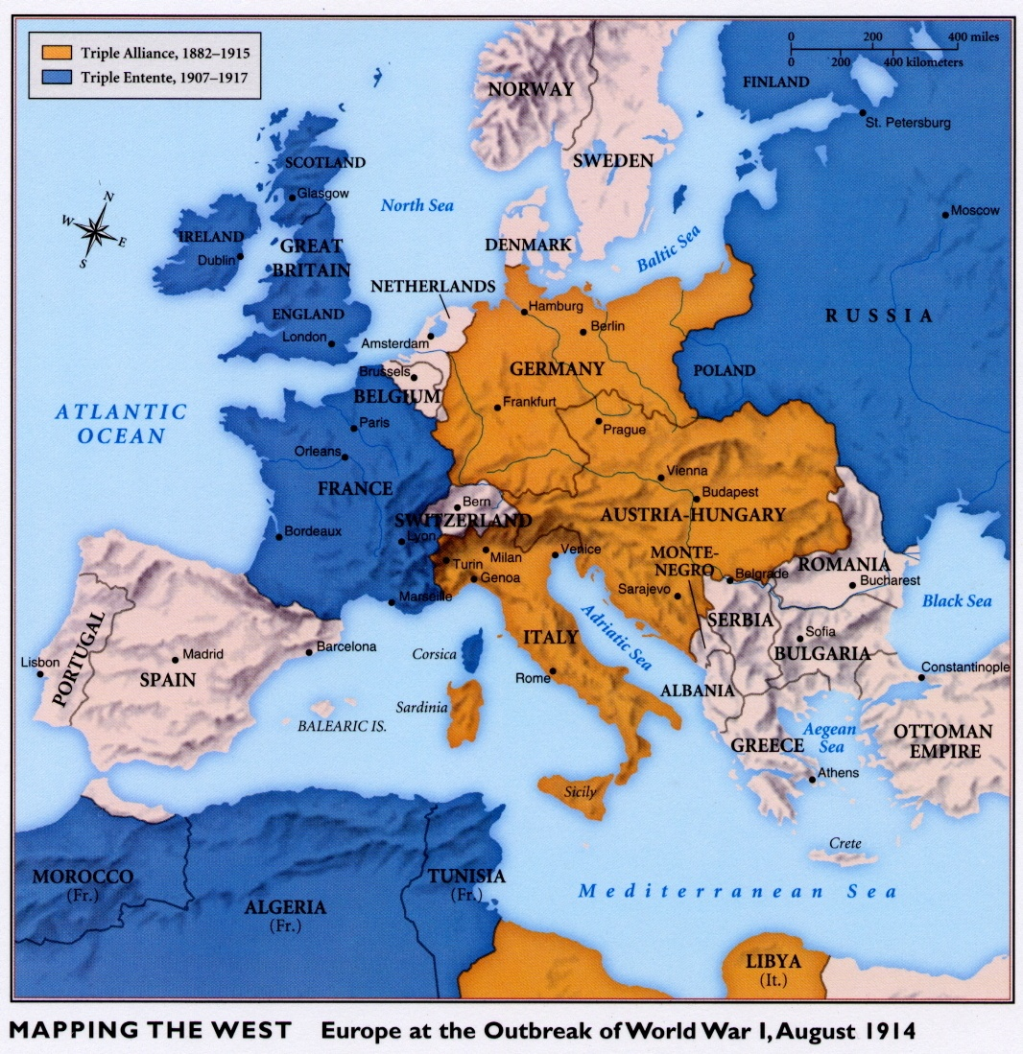

Slide 14
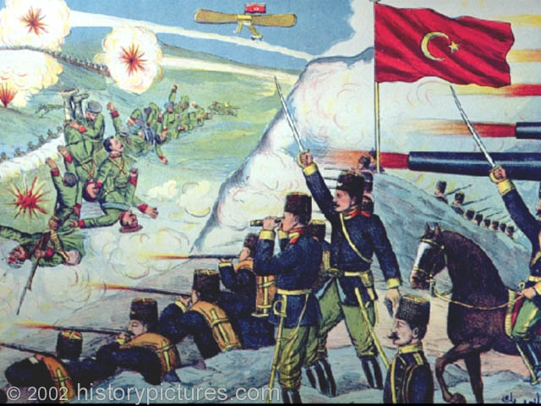
5. Balkan “Powder Keg”
International “hot spot”
Austria, Russia & Turks
Ethnic tension & nationalism
Slavic Nationalism = Serbia
Painting of a battle
from the First
Balkan War (1912)
between Balkan
States & Ottoman
Turks

Slide 15
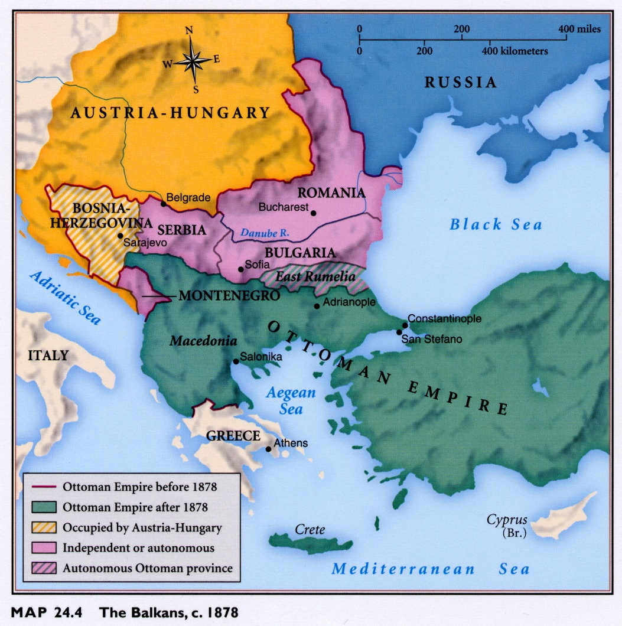

Slide 16
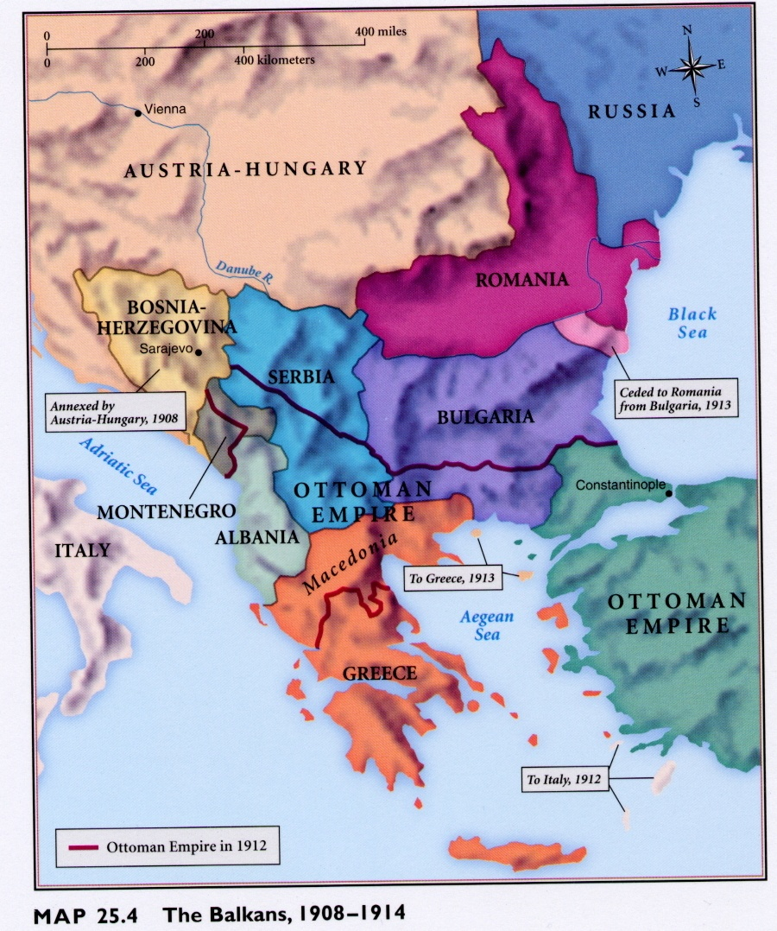

Slide 17
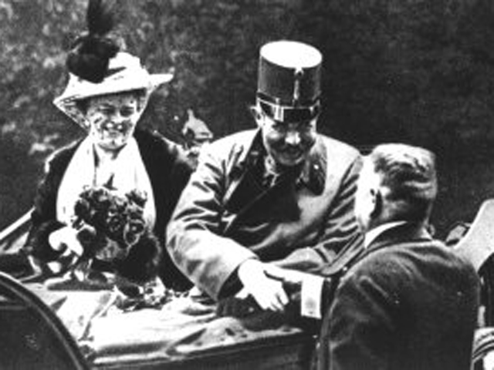
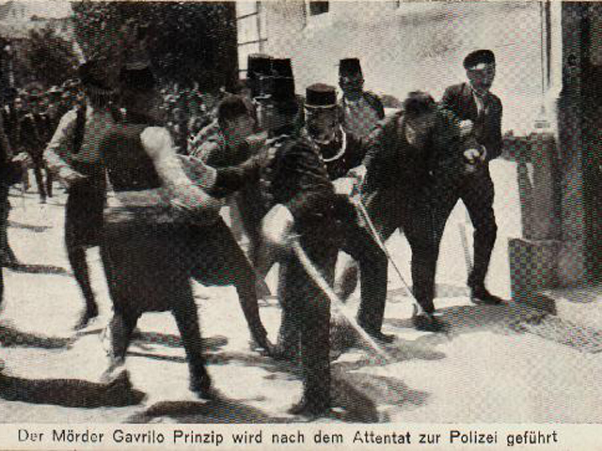
Assassination
June 28, 1914 Austrian
Archduke Franz Ferdinand
& wife are assassinated in
Sarajevo.
. . . by Gavrilo Princep &
the “Black Hand”; a
secret society of
Slavic Nationalists

Slide 18
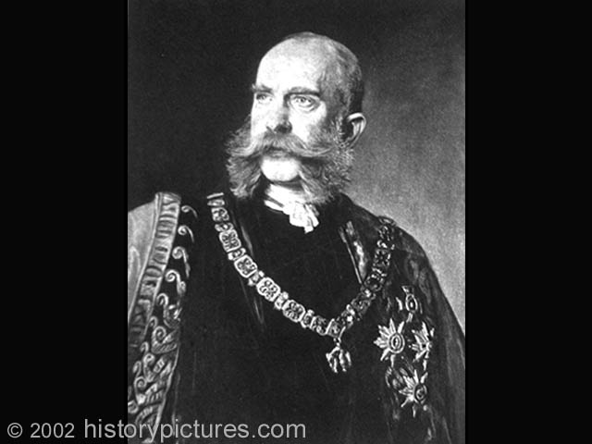
DIPLOMACY
Austria convinced of a Serbian plot & must crush Slavic nationalism.
Germany’s “blank check” of support to Austria (against Russia)
Austria’s “ultimatum” to Serbia

Slide 19
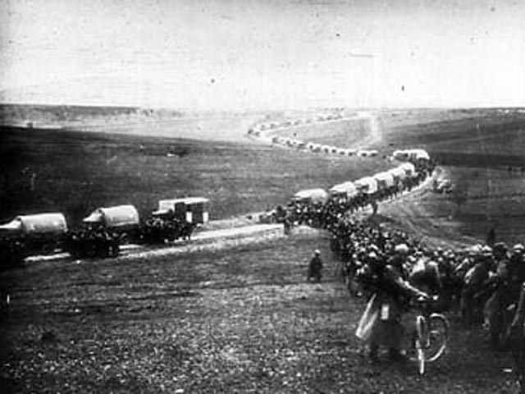
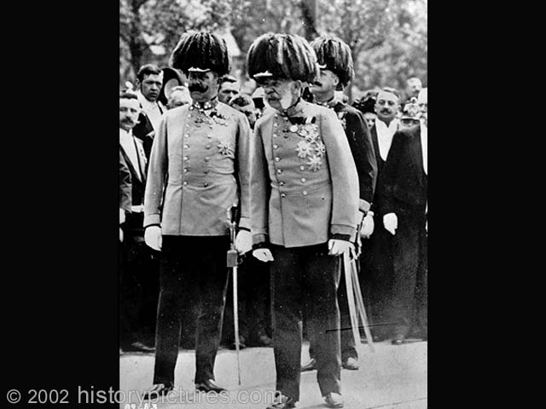
OUTBREAK OF WAR
Serbia refuses humiliating ultimatum
Austria declares war: July 28, 1914

Slide 20
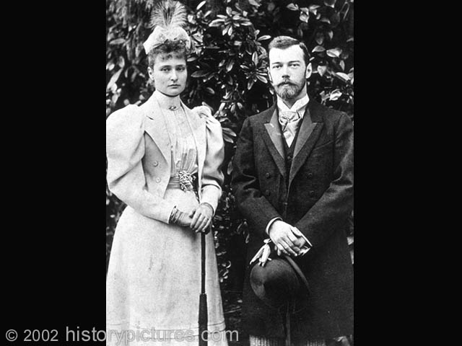
THE GUNS OF AUGUST
Russia mobilizes army
on July 30
…German / French
dialogue
Germany declares war
on Russia, August 1…

Slide 21
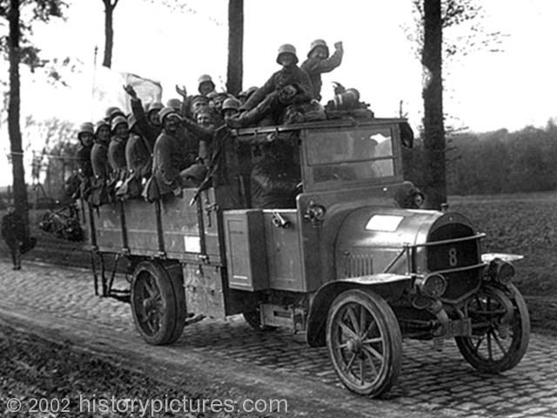
THE GUNS OF AUGUST
Germany declares war
on France . . . Aug 3

Slide 22
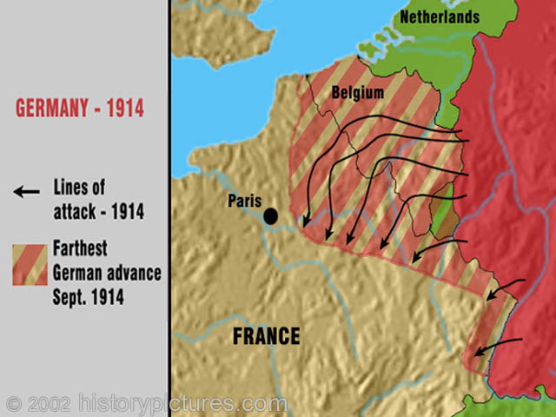
THE GUNS OF AUGUST
The “Schlieffen Plan” & neutral Belgium.
Great Britain declares war on Germany: Aug 4
(to protect Belgian neutrality – 1839)

Slide 23
THE GUNS OF AUGUST
Aug. 7 – most Balkan states join with Serbia
(against Austria )
Aug 23 – Japan declares war on Germany
(looking to seize Pacific colonies)
By Nov. – the Ottoman Empire joins the
Central Powers
(May-1915) Italy remains neutral despite Triple Alliance; will later join Britain & France
(Oct-1915) Bulgaria joins Central Powers
The United States declares its neutrality

Slide 24
Allies vs. Central Powers

Slide 26
The Chain of Friendship

Slide 27
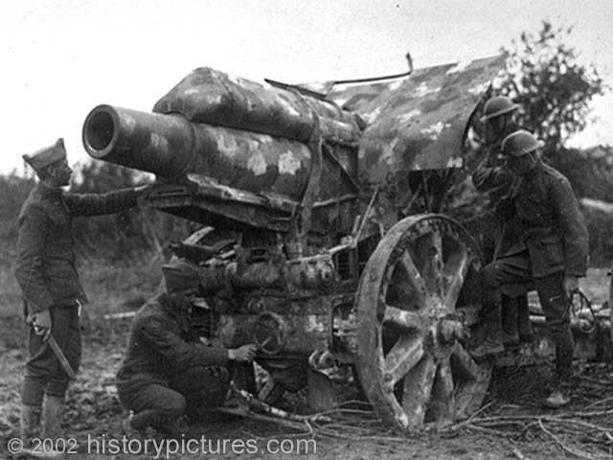
Stalemate
Advancing German troops get to within 30 miles of Paris and are stopped.
Trenches & stalemate on the Western front
“war of attrition”

Slide 28
BATTLE OF THE MARNE (SEPT, 1914)
Marne River,
East of Paris
Stopped Germany’s rapid advance
Prevented the
fall of Paris
Foiled the Schlieffen Plan
Set the stage for trench warfare

Slide 29
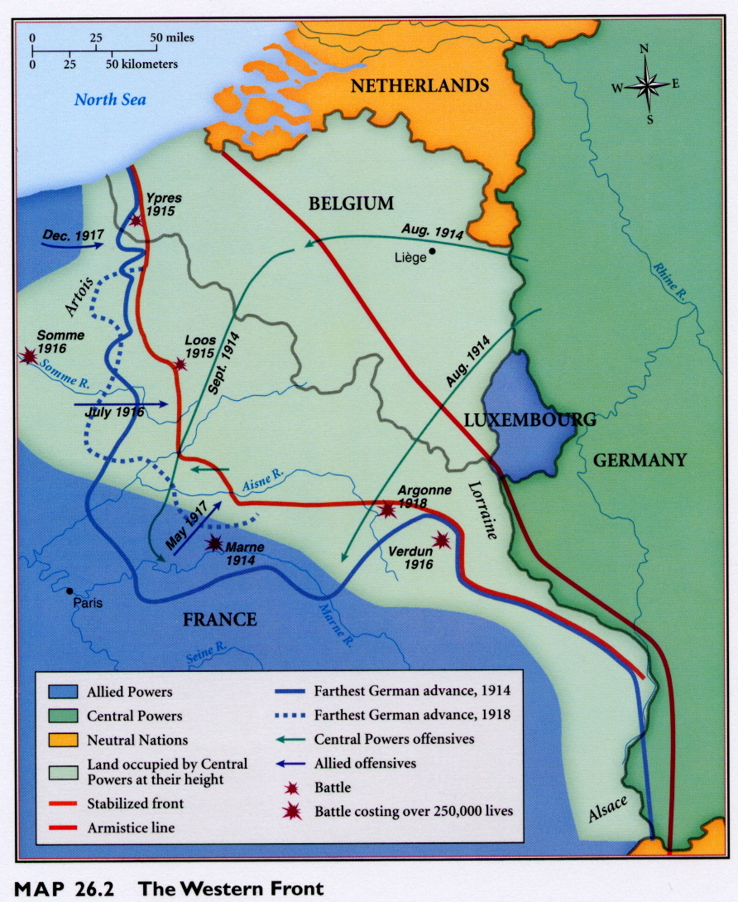

Slide 30
TOTAL WAR
All resources
devoted to the war effort
Mass production & the industrialization of war
Mobilization of the home front (factories, labor, supplies, rationing & morale)

Slide 31
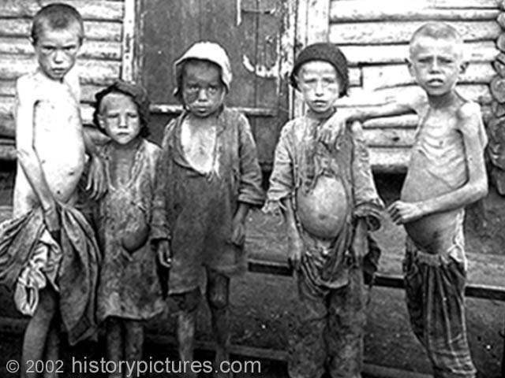
Targeting civilians to destroy morale and break the will to fight.

Slide 32
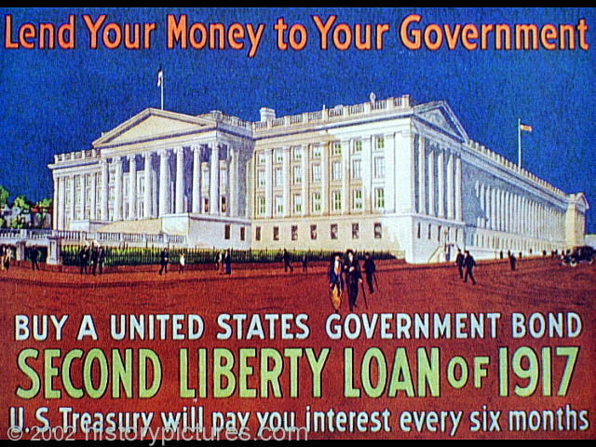
TOTAL WAR
“There are no armies… only entire nations armed.”
Many women filled factory jobs to help support the war effort & supply/equip the troops at the front.
Bonds sold to citizens to help raise money for the war effort.

Slide 33
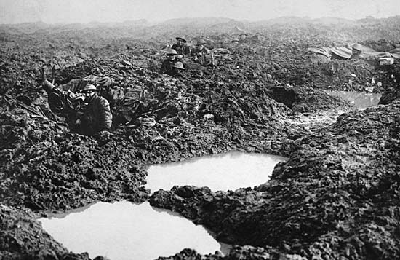
Combat & Warfare
19th century tactics against modern weapons resulted in a high number of casualties.
Trench warfare
“over the top”
“no –man’s land”

Slide 34
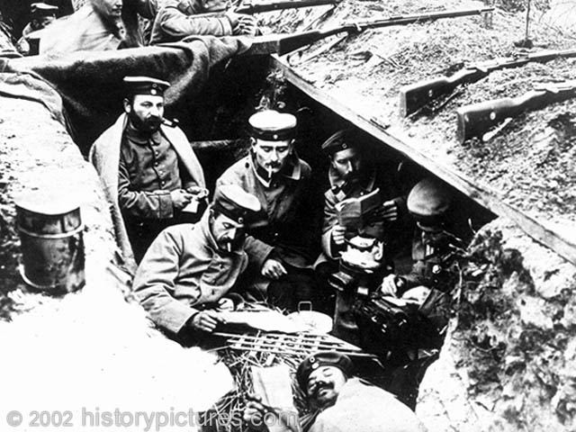
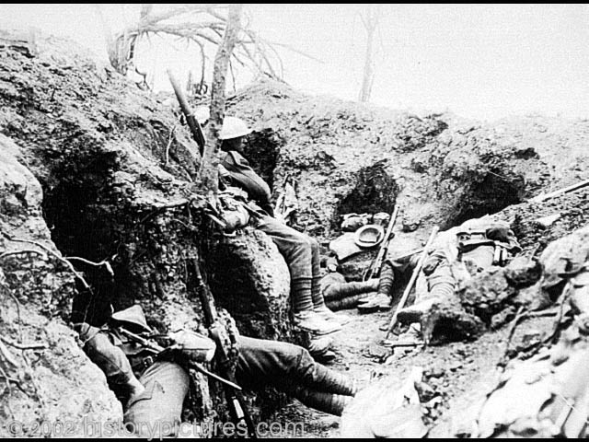
Trench Warfare
Miserable conditions: cold, wet damp, muddy, rats, disease, stench, corpses

Slide 35
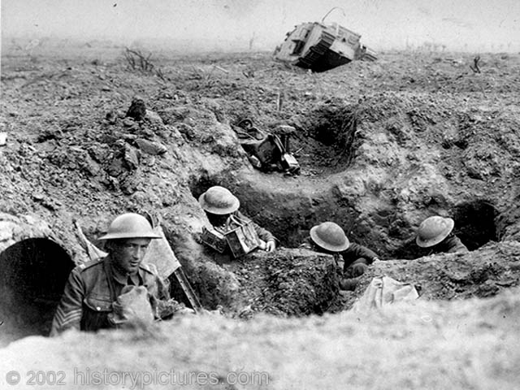
Trench Warfare
Fear, anxiety, misery…
Not the adventure & glory
many anticipated when they marched off amidst cheering crowds.
Many died horrible deaths
(@ 8.5 million) and over 20 million
wounded. Many survivors suffered
“shell shock”… A psychological
trauma due to battle fatigue and
emotional distress.

Slide 36
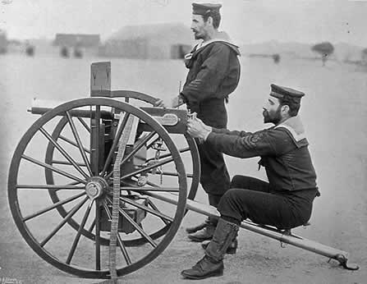
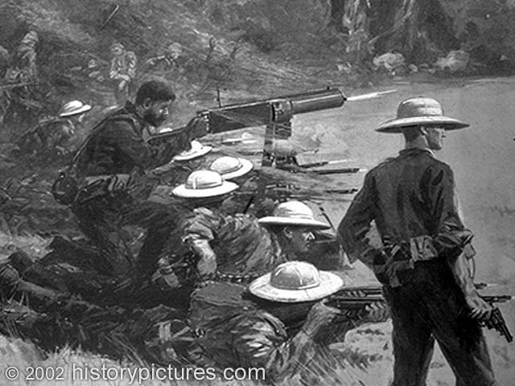
The Machine Gun
The rapid fire capability of the machine gun mowed down attacking troops who ventured into
“no-man’s land” halting any significant gains.
During an offensive. The front lines shifted very little between
Oct. 1914 – Spring 1918.

Slide 37
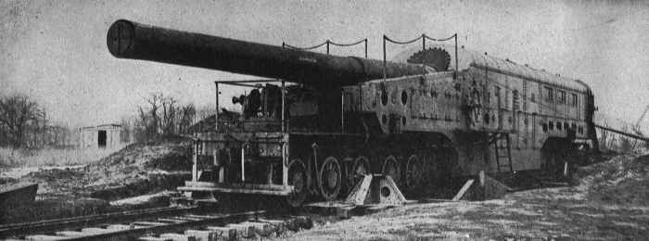
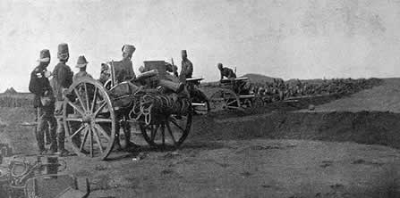
Heavy Artillery
Became more mobile and capable of bombarding enemy strongholds a great distance away.

Slide 38
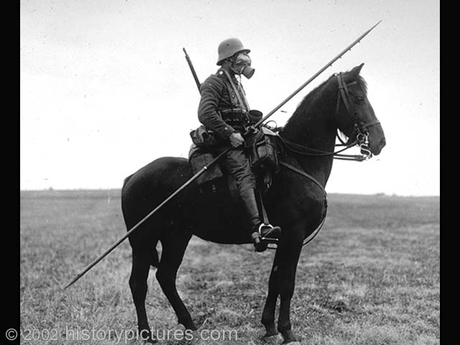
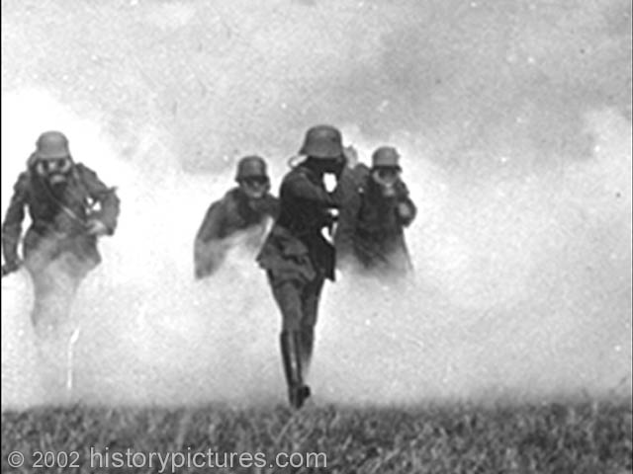
Poisonous Gas
Used for the 1st time in January 1915 by the Germans against Russian troops in Poland.
Most famous attack by the Germans against British troops at Ypres. (April, 1915)
Mustard & chlorine gas

Slide 39
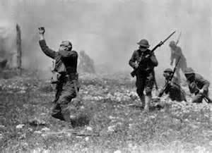
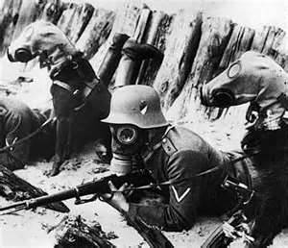
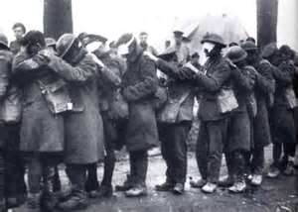
Gas! Gas! Quick boys! – An ecstasy of fumbling
Fitting clumsy helmets just in time.
But someone still was yelling out & stumbling
And floundering like a man in fire…
Dim through the misty…thick green light
I saw him drowning
In all my dreams, before my helpless sight,
He plunges at me, guttering, choking, drowning.

Slide 40
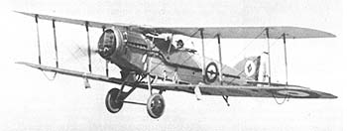
Airplane / Zeppelins
Aerial Dogfight
Originally used as “spotters” for
observation. Later , fought for control of
the skies, attacked troops on the ground
and brought the war to the home front
with bombing raids.
British fighter plane
German zeppelin

Slide 41
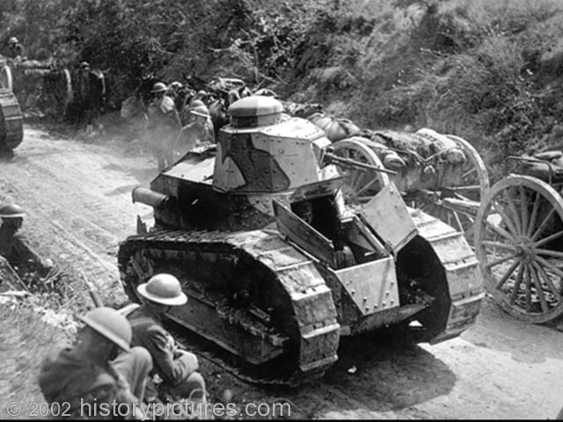
TANKS
Developed by the British. The
name “tank” developed from
A deceptive code name.
First used by the British
At the battle of the Somme
In 1916.
First successful tank offensive was
At the battle of Cambrae in 1917
When 400 Allied tanks were able to
Breach the German lines.

Slide 42
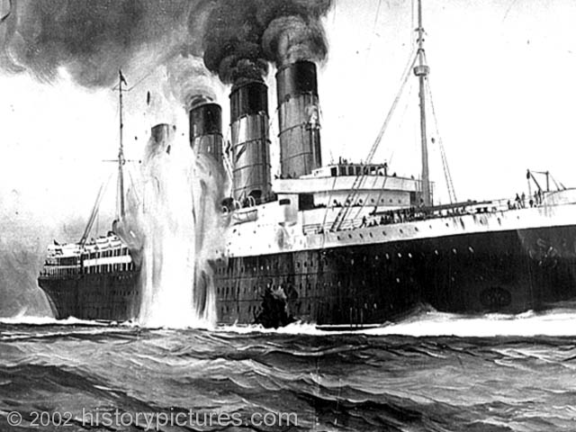
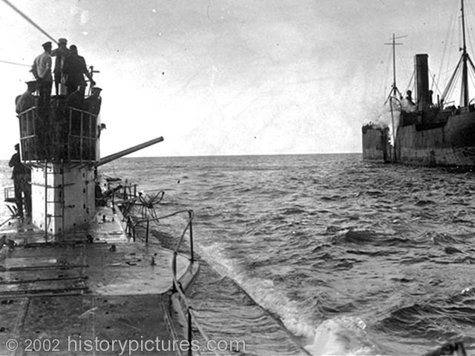
SUBMARINES
Germany used “U-boats” to
Both attack Britain’s naval
Blockade and cut off British
trade .
Unrestricted submarine warfare
affected & angered the U.S.
contributing to our entry .

Slide 43
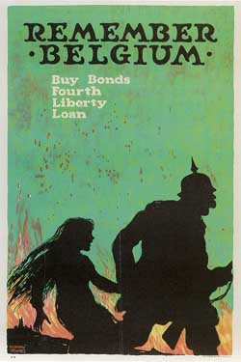
PROPAGANDA
What is the purpose
of propaganda?

Slide 44
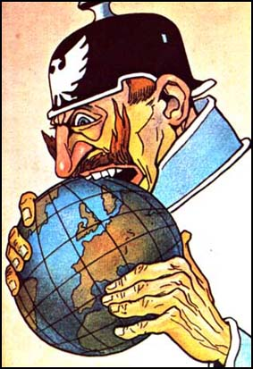
PROPAGANDA
Information designed to influence public opinion.
Appeals to emotions
Dehumanizes the enemy,
emphasizing
atrocities & brutality
The Kaiser as a world threat.

Slide 45
PROPAGANDA
To gain foreign sympathy & support
To “sell” the war & build morale
To justify your war effort
Effects news of the war
Britain & the U.S.
French recruitment poster
Rallying young men to defend
Their homeland.

Slide 46
PROPAGANDA – “sell the war”

Slide 47
PROPAGANDA

Slide 48
PROPAGANDA

Slide 49
PROPAGANDA
Effective British propaganda as well as the U.S. Government’s Committee of Public
Information, led to anti-German feelings & support for the war in the U.S.
Germans depicted
as brutes & were
dehumanized as
barbaric monsters
through
propaganda.

Slide 50
Events of the War
Germany invades France – Schlieffen Plan
Battle of Tannenberg (late Aug -Sept.1914)
Russian mobilization & invasion of Germany
Russians thrown back 30k dead, thousands surrender
By 1916, Russian casualties
over 1 million
German troops
at Tannenberg
Surrendering Russian
soldiers

Slide 52
Events of the War
Battle of the Marne (Sept. 1914)
halts German offensive & creates “stalemate” on the Western Front
Parisian taxi cabs race
French troops to help
intercept Germans
at the Marne River

Slide 54
Events of the War
Battle of Gallipoli (1915-16)
Allied attempt to aid weakening Russia
Straits to Black Sea & Constantinople
Bloody failure
ANZAC troops land on
the Beaches of Gallipoli

Slide 56
Events of the War
Italy (1915)
Secret deal with the Allies
1916 Battle of Copretto
Italian troops in action
against the Austrians

Slide 57
Events of the War
War at Sea
British Blockade & German “U-Boats”
Battle of Jutland (1916)…a “draw”

Slide 59
6. United States Entry
U.S. neutrality
Trade & “contraband”
Successful British propaganda
Blockades & unrestricted sub warfare
Sinking of the Lusitania (1915)
U.S. response and the
Sussex Pledge
German torpedoes slam into the Lusitania

Slide 60
PROPAGANDA
Information designed to influence public opinion.
Appeals to emotions
Dehumanizes the enemy,
emphasizing
atrocities & brutality
The Kaiser as a world threat.

Slide 61
PROPAGANDA
Effective British propaganda as well as the U.S. Government’s Committee of Public
Information, led to anti-German feelings & support for the war in the U.S.
Germans depicted
as brutes & were
dehumanized as
barbaric monsters
through
propaganda.

Slide 62
United States Entry
U-Boats & Unrestricted Submarine Warfare
What was the significance of the Lusitania?
What were “cruiser rules?”
What was “unrestricted sub warfare?”
Why did the Germans use this and what did they hope to accomplish?
The Zimmerman Telegram
Who was the U.S. President during WWI?
What promise did Germany break?
What was the Zimmerman Telegram?
Why was it written in code?
How did it lead the United States to enter WWI?

Slide 63
United States Entry
Success of British blockades & resumption of unrestricted warfare
Zimmerman Note (Jan, 1917)
German appeal to Mexico
British intercept &
American outrage
April 6, 1917 U.S. declaration
of war against Germany
Pres. Wilson, “Make the world
safe for democracy”

Slide 64
Russia: Czar Nicholas II & wife Alexandra
Nicholas & son Alexei
The “mad monk” Rasputin
who was later assassinated.

Slide 65
Russia Withdraws
Problems leading to Revolution in Russia
Political:
Czar was an autocrat with absolute power
No opposition allowed; secret police
Repressed all ideas of change
Suffering people have no real
“voice” in government
The last Romanov czar Nicholas II (1894-1917)

Slide 66
Russia Withdraws
Bloody Sunday & 1905 Revolution
Peaceful protest in St. Petersburg fired on by czars palace guard triggers uprising
Czar limits the “Duma” (Parliament) & unfair taxes on commoners
Humiliating defeat vs. Japan in 1905

Slide 67
Russia Withdraws
Economic
Suffering peasants & poverty
Poor food production
Overpopulation in the cities
Discontented workers & factory strikes
No growing “middle class”
Growing gap between wealthy elites & commoners
Radicals who believe the czar must go for serious change to appear: 1881 terrorist plot kills Czar Alexander II

Slide 69
Russia Withdraws
Russia in World War I:
Economically weak & poorly trained
Soaring casualties in the war & low morale
Lack of supplies & food shortages
(at front & home)

Slide 70
7. Russia Withdraws
Miserable conditions at the front & at home
1917 March Revolution &
Provisional Government
Czar Nicholas abdicates
New government pledge to remain in the war
Allies happy, but unpopular with the people
Poster that
Commemorates
the March
Revolution

Slide 71
Russia Withdraws
Lenin returns to Russia
April Thesis, “Peace, Land, Bread”
“All land to the peasants” – socialism
Immediate socialist revolution under a dedicated Bolshevik Party

Slide 72
7. Russia Withdraws
Vladimir Lenin & the Bolshevik s
(radical “Marxists” = Communist Party)
“peace, land & bread” – “All land to the peasants.”
November Revolution & take-over
Treaty of Brest-Litovsk (March-1918)
Russia withdraws
from the war
Gives up a large amount
of land to Germany
Germans can focus on the
Western front!

Slide 74
“Russia’s Dark Hour”

Slide 75
Union of Soviet Socialist Republics = USSR (1922)
After a bloody civil war killed millions (1918-21), Lenin used secret police, censorship & silenced, eliminated all opposition
Czar & his family are murdered July 16, 1918
Lenin puts economy under gov’t,
control (Communism), but it fails.
Later uses some capitalism

Slide 76
Joseph Stalin (1928-1953)
1928 – Stalin establishes a dictatorship or “police state.”

Slide 77
8. Central Powers Collapse
Germans withdraw to Hindenberg Line by late 1917…regroup and launch last offensive by March 1918
U.S. troops in large numbers by summer 1918
General John Pershing & Marshal Foche
Battles: Chateau Thierry, St. Mihiel and Argonne Forrest
American “doughboys” on the
march at St. Mihiel; 1st battle that
saw Allies exclusively use Americans

Slide 78
“The Last Throw” (of the Dice)

Slide 79
“On The Run”

Slide 80
Surrender - 1918
Bulgaria – Sept. 1918
Ottoman Empire collapses by October
Revolts in Austria-Hungary results in their
withdrawal on Nov. 3
Kaiser William forced to abdicate
Weimar Republic = new government ; signs the armistice (cease-fire) on Nov. 11, 1918

Slide 81
Surrender - 1918

Slide 82
9. November Armistice (1918)
“On the 11th hour of the 11th day of the 11th month, the guns of WWI fell silent.”
Crowds celebrate
the announcement
of the armistice.

Slide 83
CHP. 29 – WWI Homework Questions
What were some of the problems faced by the peacemakers at Versailles?
Who was Woodrow Wilson ? What were his 14 Points and what goal did he hope to accomplish with them?
How was the European view of what the treaty should contain different that Wilson’s?
Why did the United States government eventually reject the Treaty of Versailles?
Why do you think the treaty failed to keep long-term peace?

Slide 84
WWI – CASUALTY STATISTICS
NATION | TOTAL SERVICEMEN IN WAR | NUMBER OF DEATHS | NUMBER OF WOUNDED
AUSTRIA | 7,800,000 | 1,200,00o | 3,620,000
BRITISH EMPIRE | 8,904,467 | 908,371 | 2,090,212
FRANCE | 8,410,000 | 1,357,800 | 4,266,000
GERMANY | 11,000,000 | 1,773,700 | 4,216,058
ITALY | 5,615,000 | 650,000 | 947,000
RUSSIA | 12,000,000 | 1,700,000 | 4,950,000
TURKEY | 2,850,000 | 325,000 | 400,000
UNITED STATES | 4,355,000 | 126,000 | 234,300
Which country had the most soldiers in WWI?
Which country had the least?
Which country had the highest number of deaths? (Why?)
Which country had the fewest? (Why?)

Slide 85
Costs of the War
Over 8 million combat deaths
20 million wounded
Over 10 million civilian casualties
(numerous homeless & hungry)
@ $400 billion in damage (European economies
drained)
Collapse of 4 empires
Balance of power shattered

Slide 86
U.S. War Casualties
Revolutionary War (1775-1783) : @25,300
Civil War (1861-1865) : @500,000
Spanish American War (1898) : @2,500
World War I (1917-1918) : @116,500
World War II (1941-1945) : @407,000
Korean War (1950-1953) : @54,000
Vietnam War (1961-1973) : @58,500
Iraq War (2003-2009) : @4,250

Slide 87
Versailles YOU
Countries involved in negotiations
Plan
(goals / themes)
3. Map
4. Damages or reparations
5. Guilt / blame
6. Peacekeeping

Slide 88
Chp. 29 – sec. 4: A Flawed Peace
What were the guiding principles of the 14 points?
What were concerns & aims of France & Britain?
In what ways did the treaty punish Germany?
How did the treaty change the world map?
How was Wilson’s 14th Point incorporated into the Versailles Treaty?
Why did the United States reject the treaty?
How did this rejection affect the League of Nations?

Slide 89
PEACE TREATY
Problems
Boundaries, territory & demands
Nationalist demands
War damages & reparations
Peace-keeping measures
A meeting at the Paris Peace
Conferences (1919)

Slide 90
Paris Peace Conferences
Peace plan / View #1
Peace plan / View
#2
Peacemakers / Delegates
Terms of Versailles Treaty
Changes to the map

Slide 91
PEACEMAKING
Who made the major decisions of the peace treaty?
What were the 2 different views / plans of what the peace treaty should be like? Who held each view?
What was the treaty signed with Germany?
How did it effect Germany?
How did it change the map?
How was Woodrow Wilson’s 14th point incorporated?
Why did the U.S. reject the
treaty?

Slide 92
PEACE TREATY
Delegates
32 nations
No Central Powers
Decision making
controlled by the
“Big Four”:
David Lloyd George – Great Britain
Vittorio Orlando – Italy
Georges Clemenceau – France
Woodrow Wilson – United States

Slide 93
3. Peace Plans
14 Points – U.S. President Wilson’s peace plan to achieve a “just & lasting peace.” (Jan 1918)
He believed there must be a “peace without victory,” otherwise bitterness could lead to hatred & revenge = another war.
He also insisted
WWI must be the
“war to end all wars”

Slide 94
Peace Plans
Europeans blame Germany for the war & are bitter over the destruction.
Interested in revenge
Want to “punish” Germany to prevent future aggression
Have territorial demands (secret agreements)
Meeting at
the Hall of
Mirrors in
Versailles
Palace

Slide 95
Which Plan is Best???
“A Just Peace” (peace without victory)
Vs.
“A Peace of Revenge” (punishment)

Slide 96
The Treaty of Versailles
Allied peace treaty with Germany
Signed May, 1919 by the Weimar Republic
German ministers horrified…”Diktat”
(no discussion..accept, or else)
14 points “compromised”; very harsh
Other treaties signed with other defeated Central Powers

Slide 97
The Treaty of Versailles
Conditions of the treaty for Germany:
@$32 billion reparations bill
Loss of all colonies
Military restrictions
Lost territory in Europe
(Alsace/Lorraine & the “Polish Corridor”)
Russian territory & Balkans = new states
Rhineland “demilitarized” buffer
The infamous “war guilt clause” (Article 231)

Slide 98
Humiliation at Versailles

Slide 100
The League of Nations
One of Wilson’s 14 Points that were included into the treaty was the creation of this international organization to remedy injustice, work for peace & create
a “New World Order”
But the U.S. did not join
Senate rejected treaty
League a weak failure
(wont use force)

Slide 101
Adolf Hitler (1889-1945)
“Out of the ashes of WWI, emerged Nazi Germany and the Second World War.”
Weakness & opposition to Weimar Republic
Humiliation & anger over the “Diktat”
Economic crisis (military build-up)
All Germans need to unite
together
German need for “lebensraum”
(living space)

Slide 102
“Overweighted”

Slide 103
“ALL TIED UP!”

Slide 107
Post World War I Europe
In addition, Ottoman territory in the Mid East carved into “mandates” controlled by
Britain & France

Slide 108
Post WWI Homework Questions: Use chp. 30 (sects 1-2), chp. 31 (sects 3-4) & chp. 32
What are the similarities & differences between communism & fascism?
How does a command economy work?
Identify who each of the following were:
Adolf Hitler, Josef Stalin, Benito Mussolini,
Neville Chamberlain, Winston Churchill, FDR
What was the “Versailles Diktat?”
Explain Hitler’s “Final Solution.”
What was the Nazi-Soviet Non-Aggression Pact?
What famous decision did President Truman make in 1945 and why did he make it?

